Slide 1
Functions and an Introduction to Recursion
Chapter 6 of C++ How to Program, 9/e

Slide 2
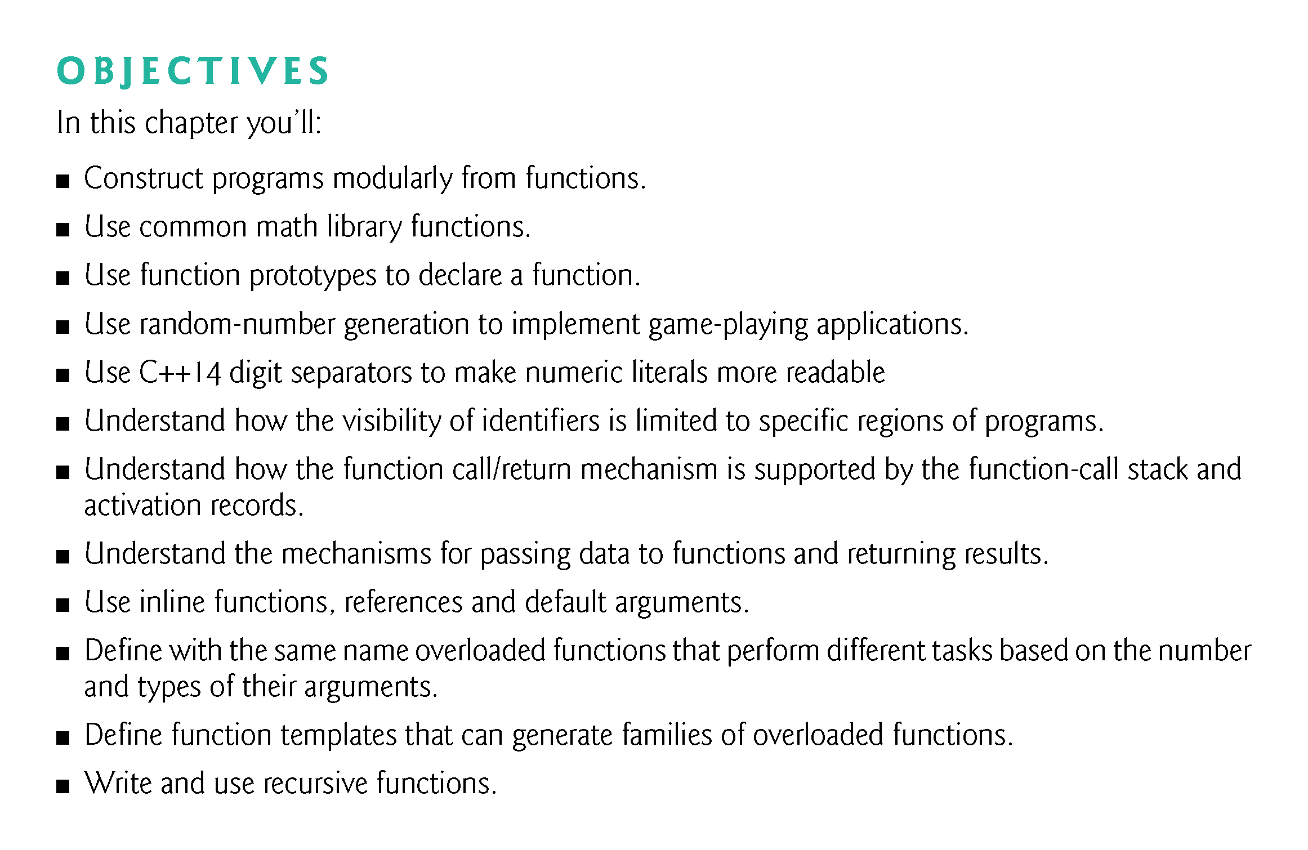

Slide 3
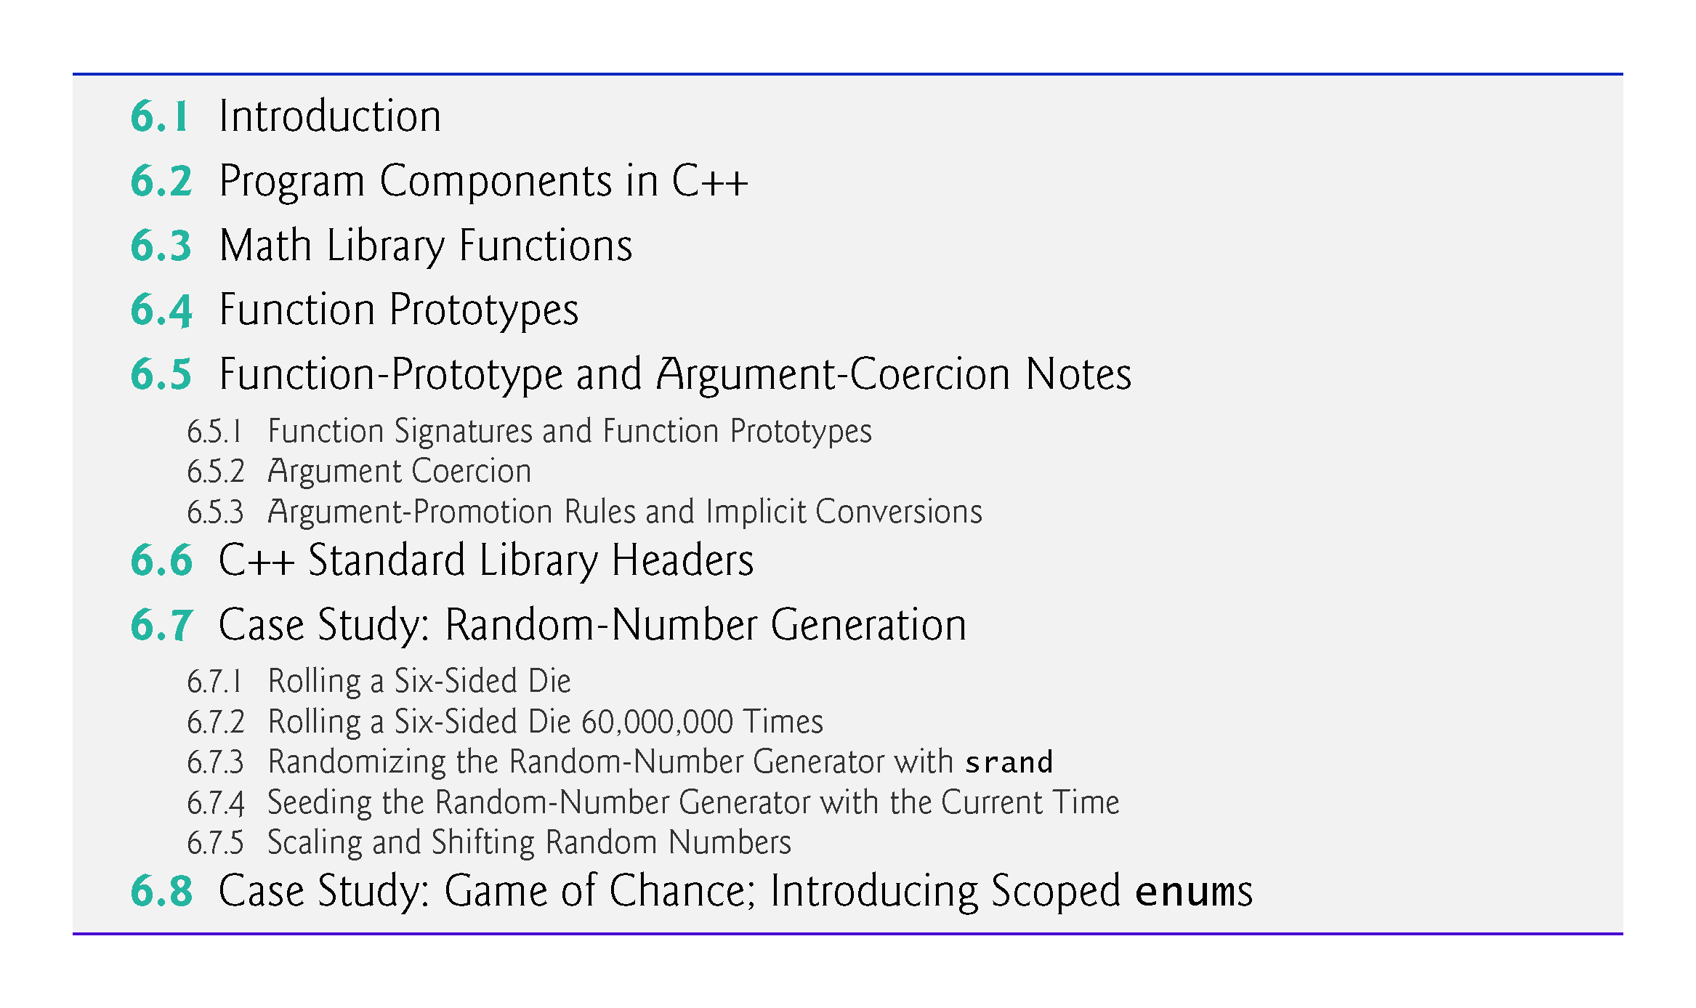

Slide 4
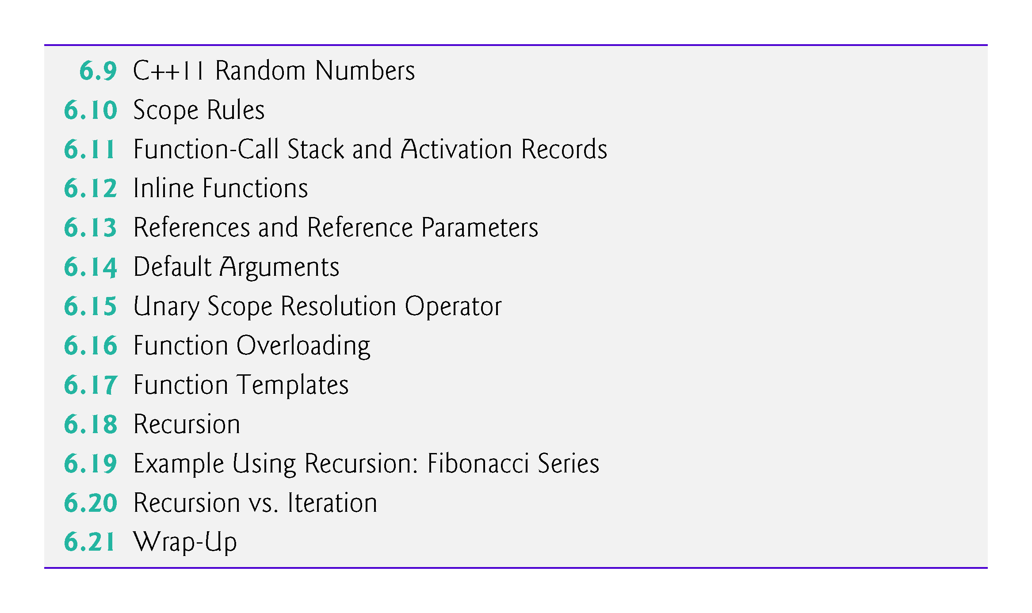

Slide 5
6.1 Introduction
Develop and maintain a large program by constructing it from small, simple pieces, or components.
divide and conquer.
Emphasize how to declare and use functions to facilitate the design, implementation, operation and maintenance of large programs.
Function prototypes and how the compiler uses them to convert the type of an argument in a function call to the type specified in a function’s parameter list, if necessary.
Simulation techniques with random number generation.
C++’s scope rules.

Slide 6
6.1 Introduction (cont.)
How C++ keeps track of which function is currently executing, how parameters and other local variables of functions are maintained in memory and how a function knows where to return after it completes execution.
Function overloading.
Function templates.
Recursion.

Slide 7
6.2 Program Components in C++
C++ programs are typically written by combining “prepackaged” functions and classes available in the C++ Standard Library with new functions and classes you write.
The C++ Standard Library provides a rich collection of functions.
Functions allow you to modularize a program by separating its tasks into self-contained units.

Slide 8
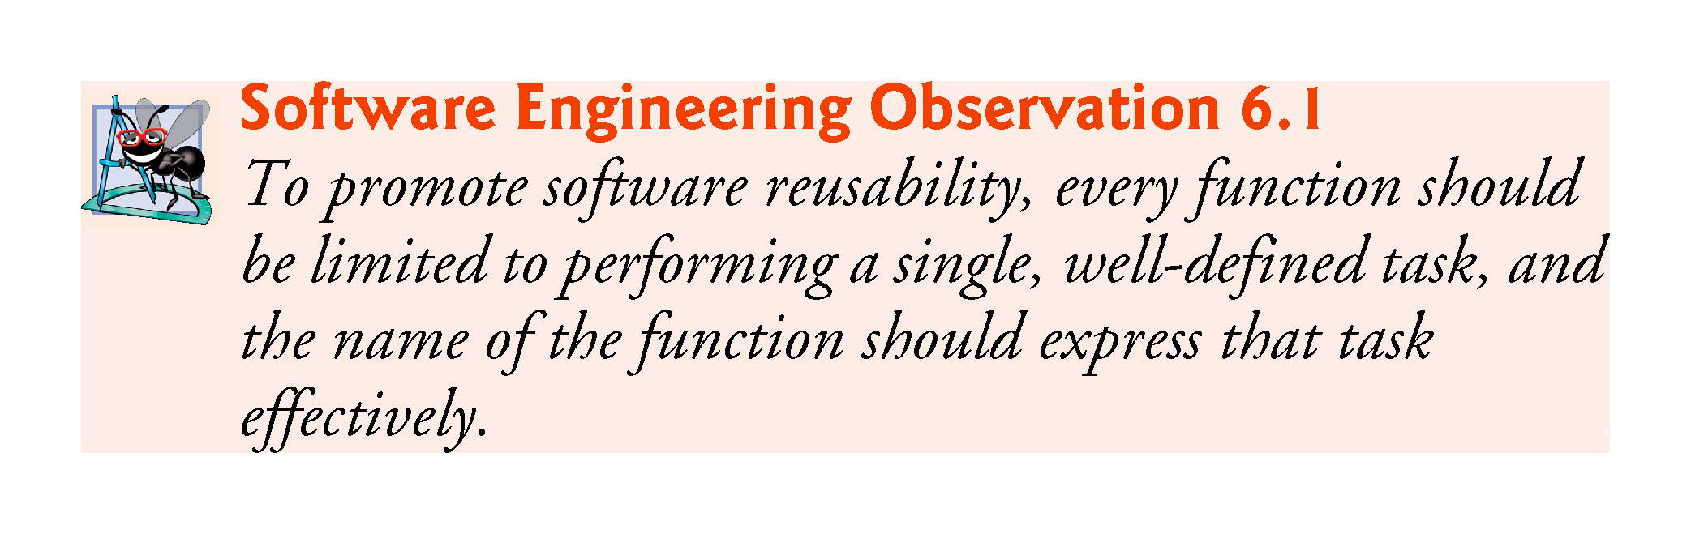

Slide 9
6.2 Program Components in C++ (cont.)
A function is invoked by a function call, and when the called function completes its task, it either returns a result or simply returns control to the caller.
An analogy is the hierarchical form of management (Figure 6.1).
A boss (similar to the calling function) asks a worker (similar to the called function) to perform a task and report back (i.e., return) the results after completing the task.
The boss does not know how the worker performs its tasks.
The worker may also call other workers, unbeknownst to the boss.
This hiding of implementation details promotes good software engineering.
The relationship does not need to be hierarchical, but often it is, which makes it easier to test, debug, update and maintain programs.

Slide 10
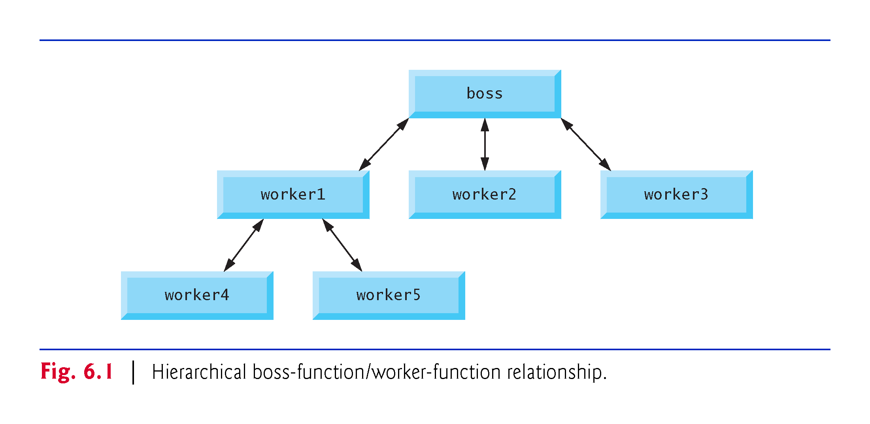

Slide 11
6.3 Math Library Functions
Sometimes functions are not members of a class.
Called global functions.
The <cmath> header provides a collection of functions that enable you to perform common mathematical calculations.
All functions in the <cmath> header are global functions—therefore, each is called simply by specifying the name of the function followed by parentheses containing the function’s arguments.

Slide 12
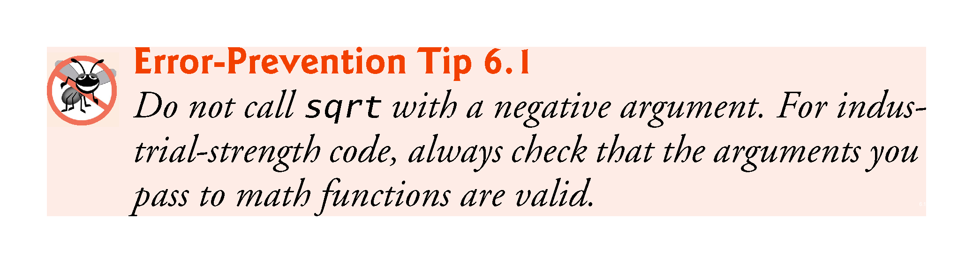

Slide 13
6.3 Math Library Functions (cont.)
Some math library functions are summarized in Fig. 6.2.
In the figure, the variables x and y are of type double.

Slide 14
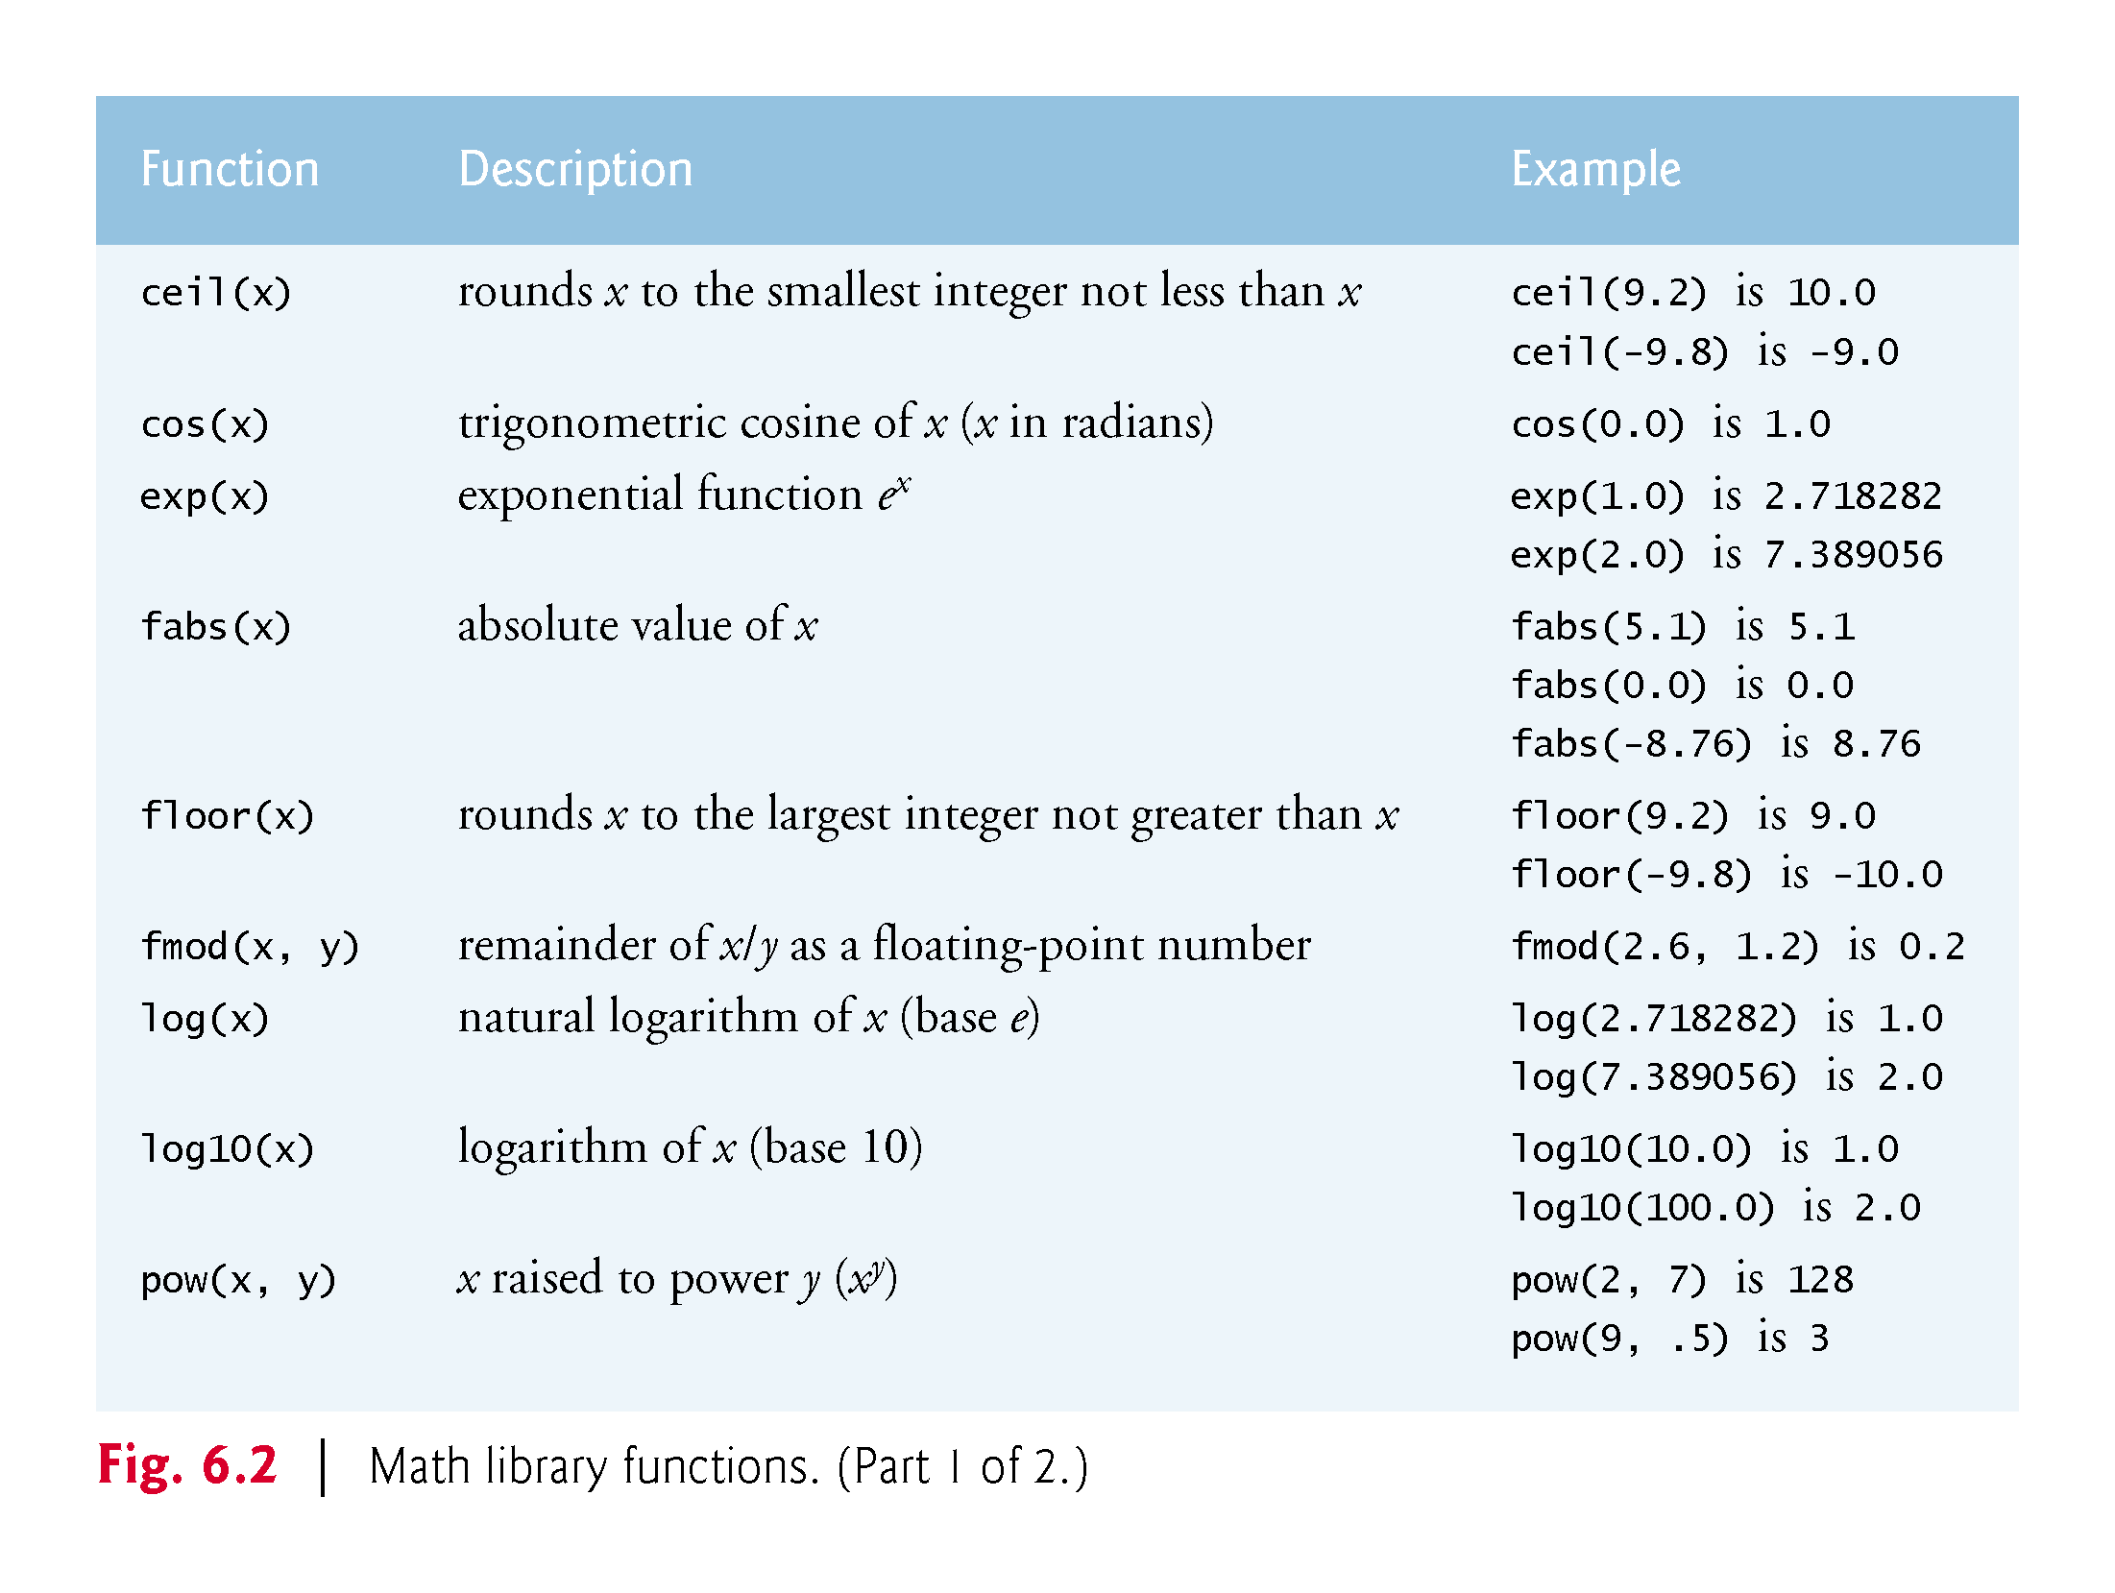

Slide 15
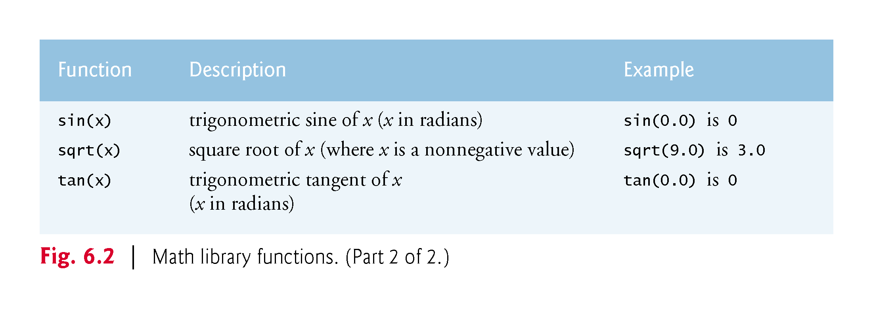

Slide 16
6.4 Function Pototypes
In this section, we create a user-defined function called maximum (Fig. 6.3) that returns the largest of its three int arguments.

Slide 17
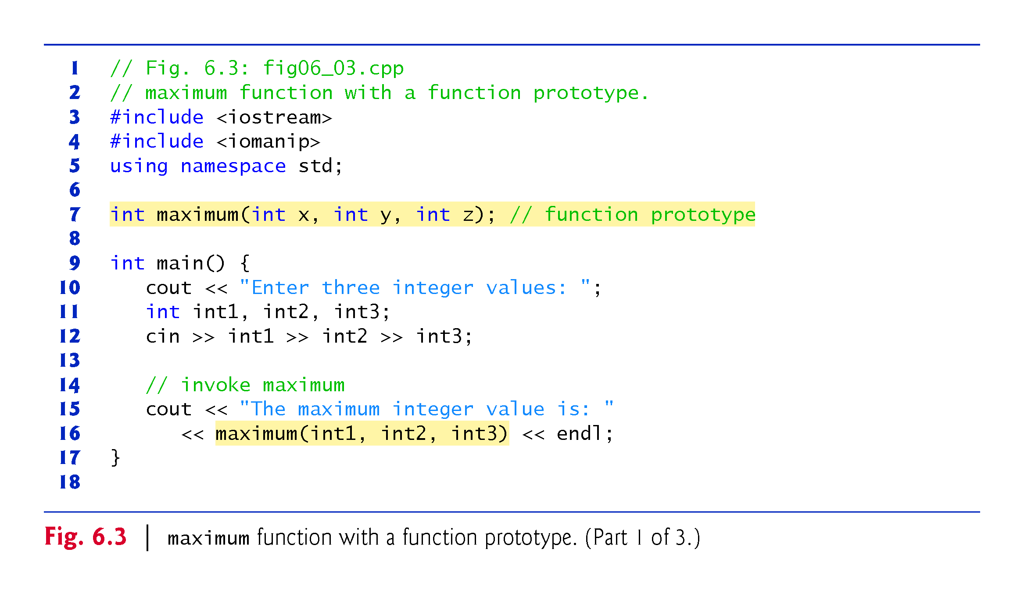

Slide 18
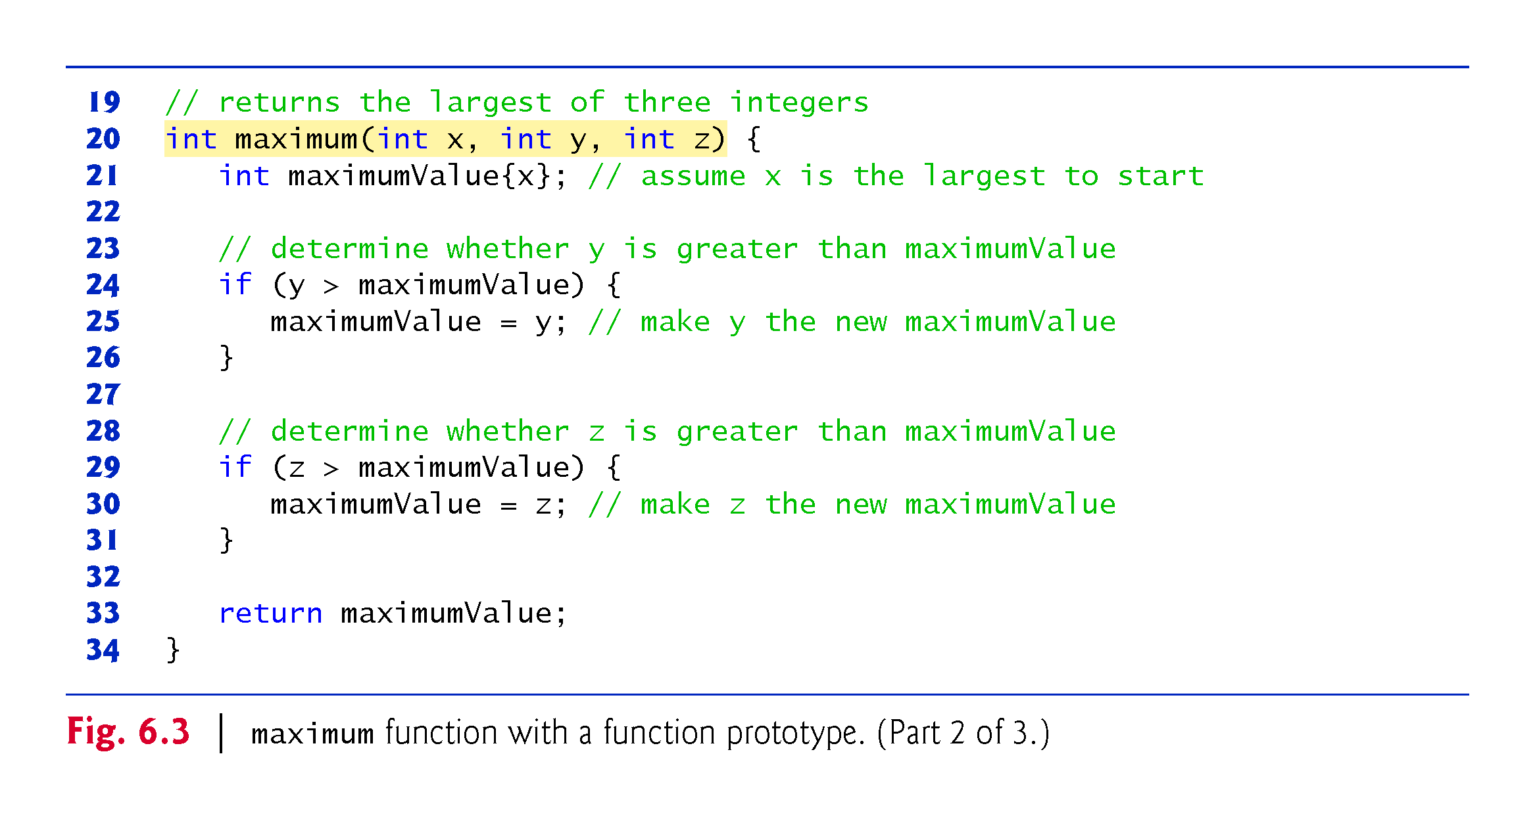

Slide 19
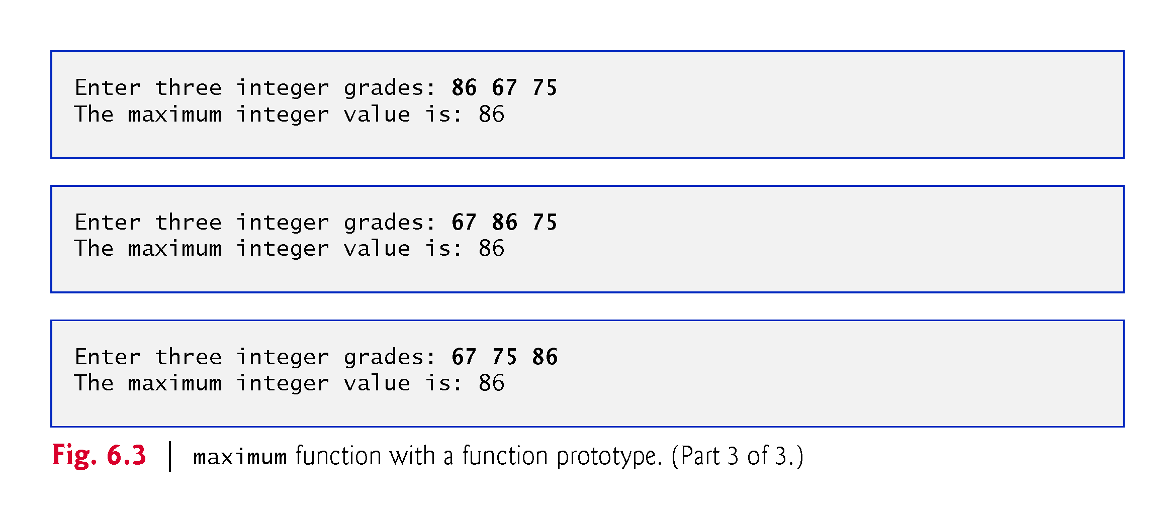

Slide 20
6.4 Function Prototypes (cont.)
In preceding chapters, we created classes with various member functions.
We defined each class in a header (.h) and included it before main in a program’s source-code file.
Doing this ensures that the class (and thus its member functions) is defined before main creates and manipulates objects of that class.
The compiler then can ensure that we call each class’s constructors and member functions correcly—for example, passing each the correct number and types of arguments.

Slide 21
6.4 Function Prototypes (cont.)
For a function not defined in a class, you must either define the function before using it or you must declare that the function exists, as we do in line 7 of Fig. 6.3:
int maximum(int x, int y, int z); // function prototype
This is a function prototype, which describes the maximum function without revealing its implementation.
A function prototype is a declaration of a function
tells the compiler the function’s name, its return type and the types of its parameters.
This function prototype indicates that the function returns an int, has the name maximum and requires three int parameters to perform its task.
The function prototype is the same as the first line of the corresponding function definition (line 20), but ends with a required semicolon.

Slide 22
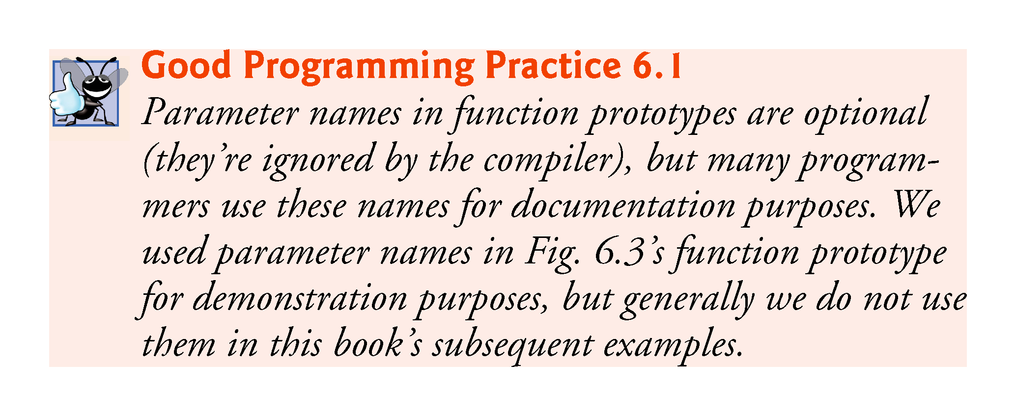

Slide 23
6.4 Function Prototypes (cont.)
When compiling the program, the compiler uses the prototype to
Ensure that maximum’s first line matches its prototype.
Check that the call to maximum contains the correct number and types of arguments, and that the types of the arguments are in the correct order.
Ensure that the value returned by the function can be used correctly in the expression that called the function.
Ensure that each argument is consistent with the type of the corresponding parameter.
If the arguments passed to a function do not match the types specified in the function’s prototype, the compiler attempts to convert the arguments to those types.

Slide 24
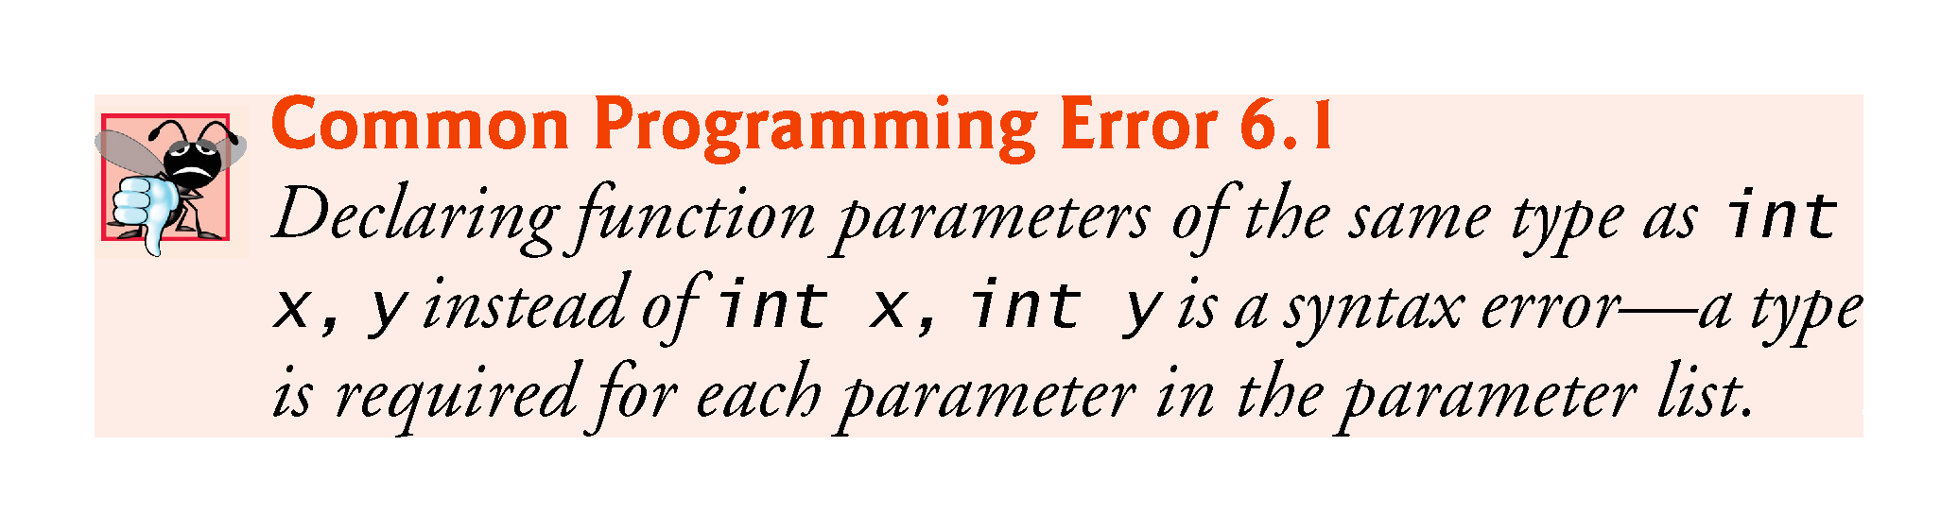

Slide 25
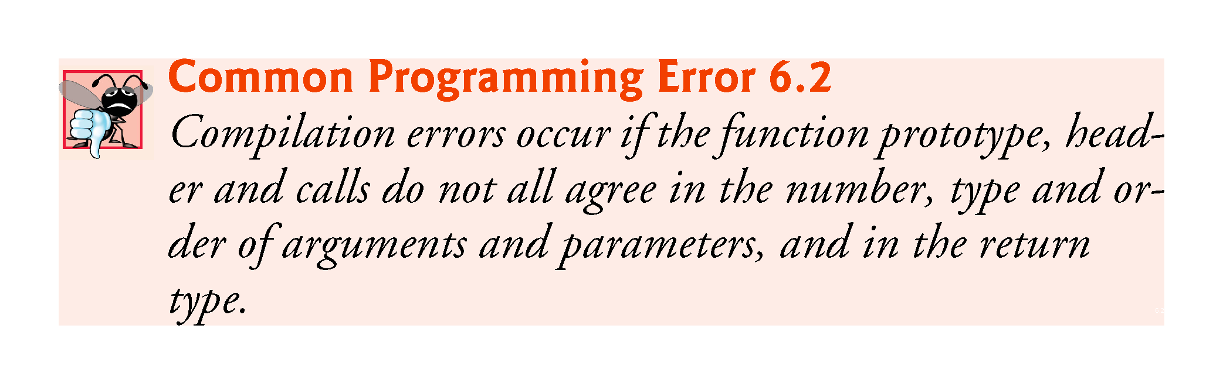

Slide 26
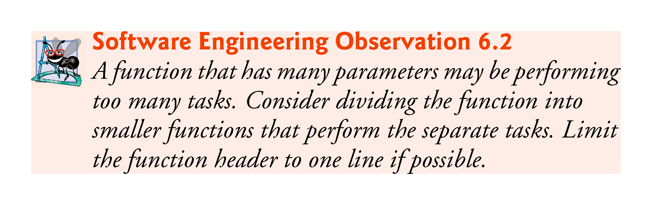

Slide 27
6.4 Function Prototypes (cont.)
Multiple parameters are specified in both the function prototype and the function header as a comma-separated list, as are multiple arguments in a function call.

Slide 28
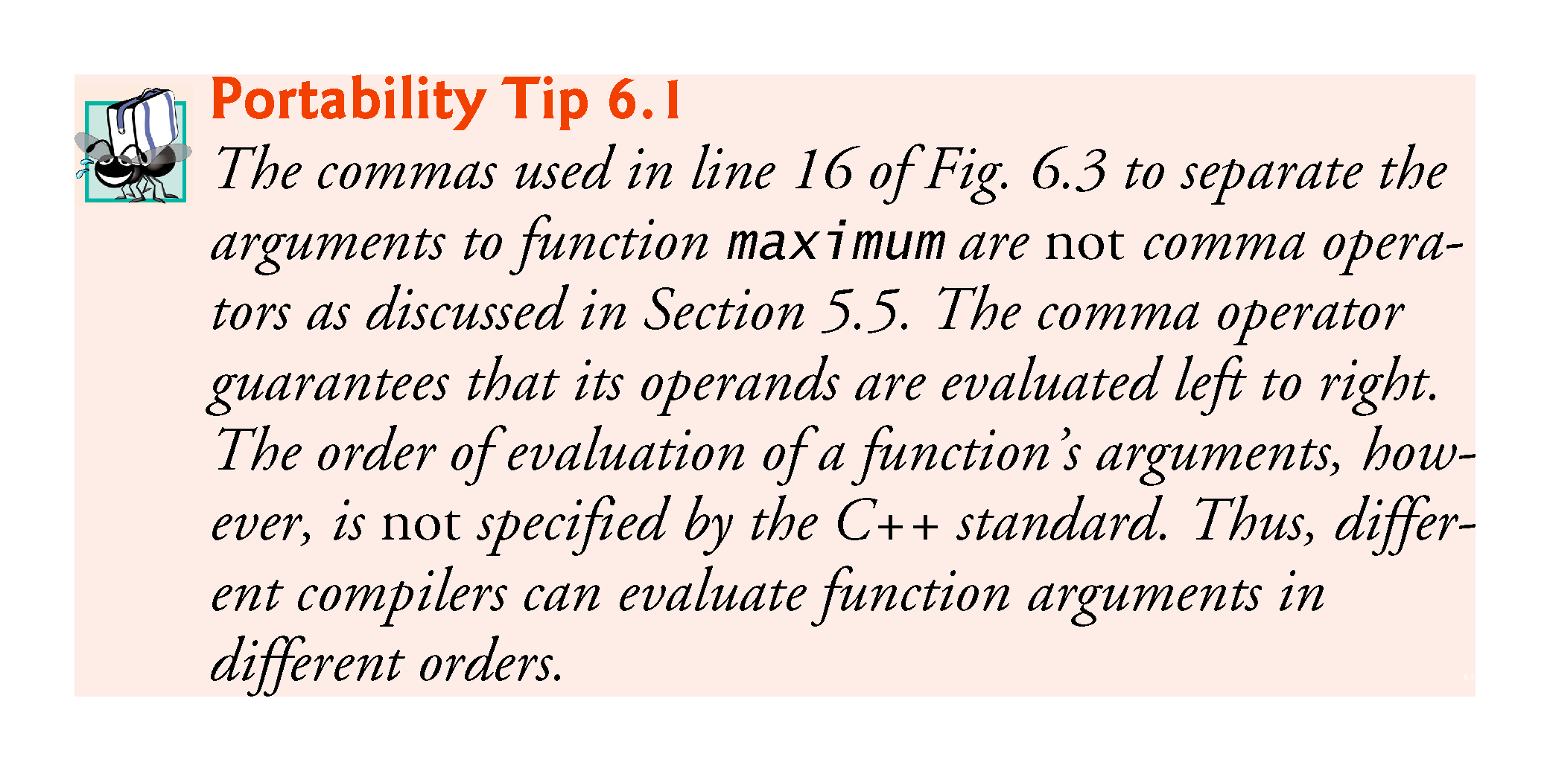

Slide 29
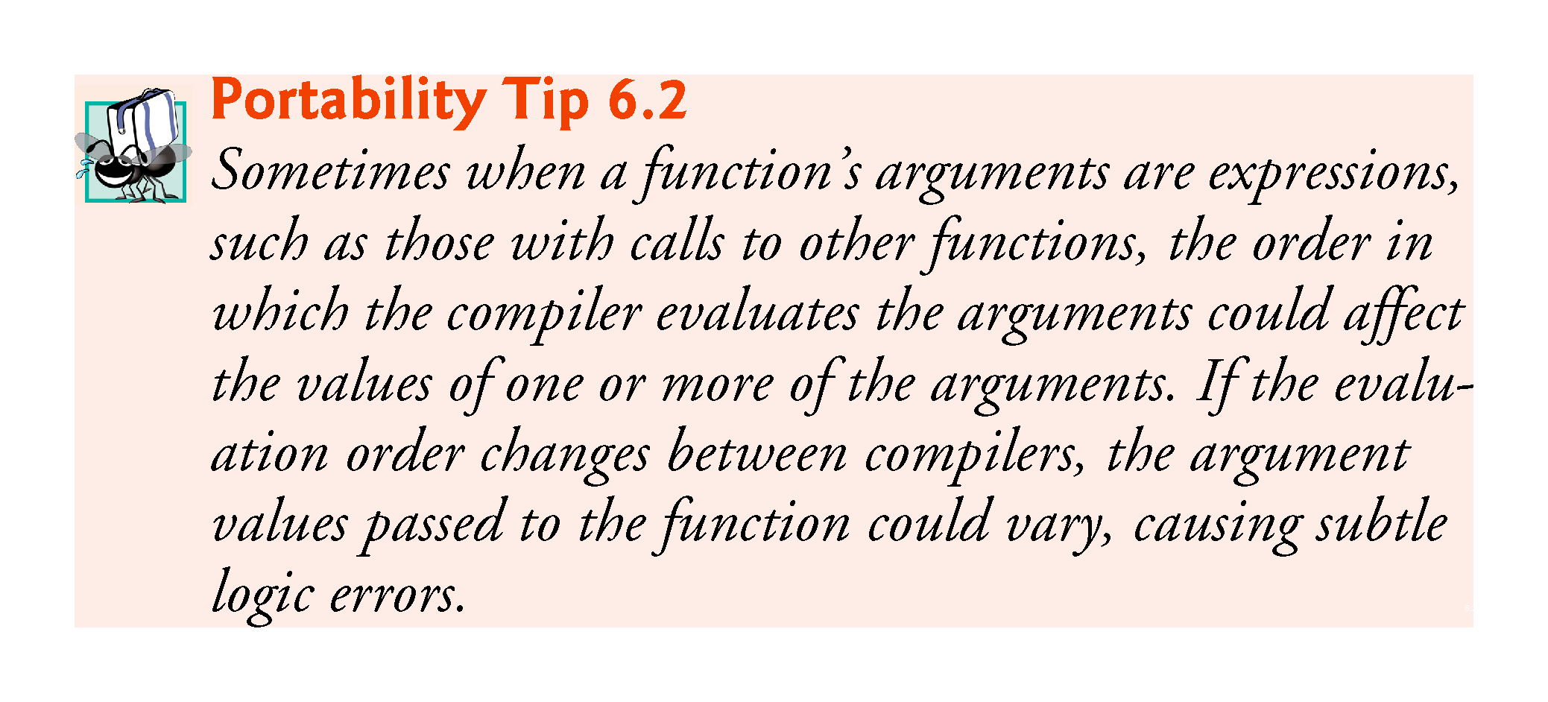

Slide 30
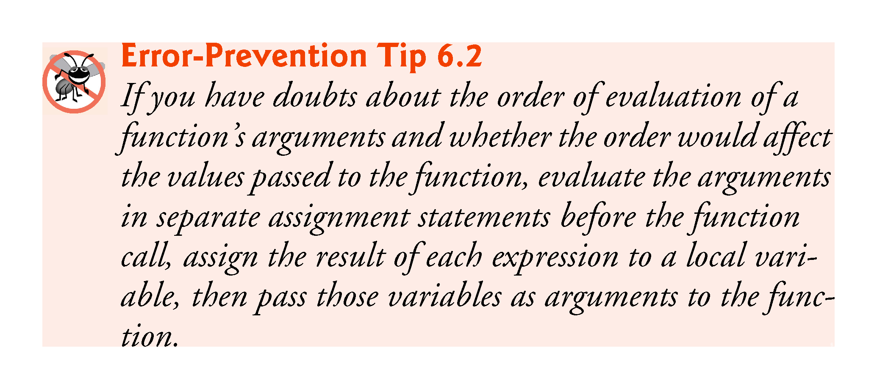

Slide 31
6.4 Function Definitions with Multiple Parameters (cont.)
In a function that does not return a result (i.e., it has a void return type), we showed that control returns when the program reaches the function-ending right brace.
You also can explicitly return control to the caller by executing the statement
return;

Slide 32
6.5 Function-Prototypes and Argument-Coercion Notes
A function prototype is required unless the function is defined before it’s used.
When you use a standard library function like sqrt, you do not have access to the function’s definition, therefore it cannot be defined in your code before you call the function.
Instead, you must include its corresponding header (<cmath>), which contains the function’s prototype.

Slide 33
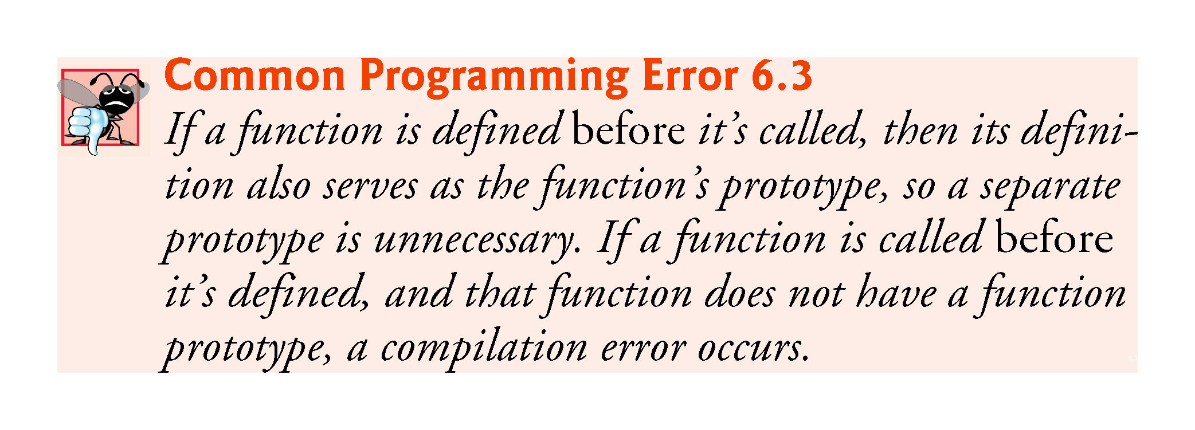

Slide 34
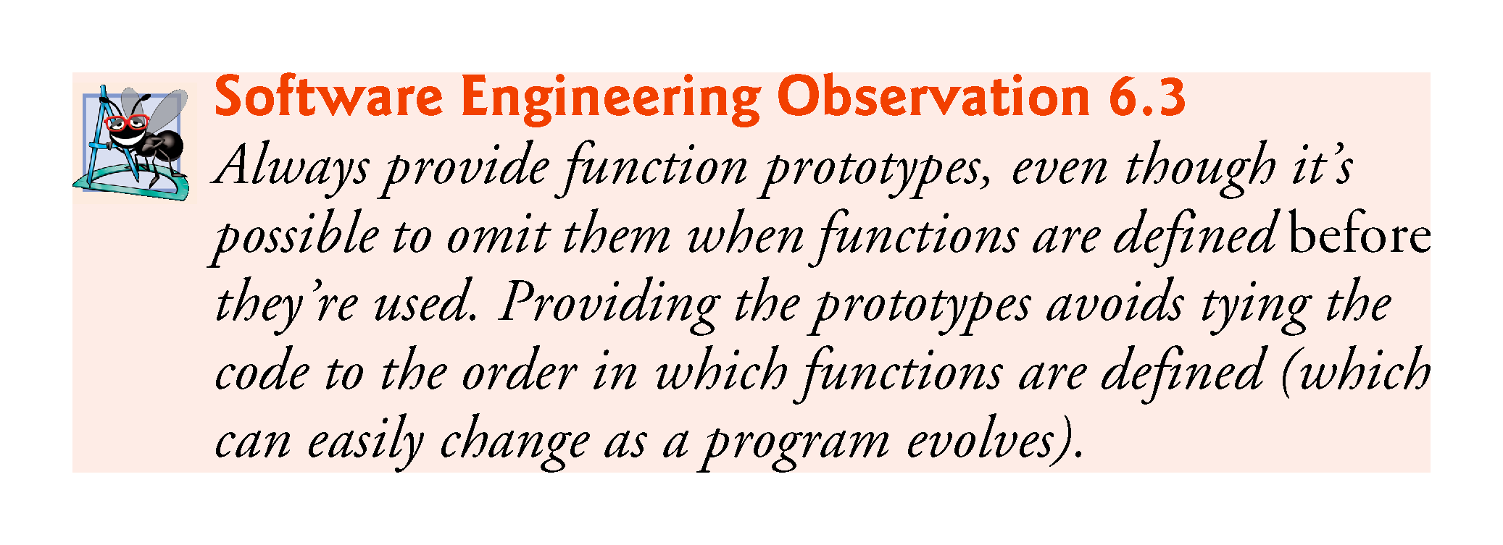

Slide 35
6.5.1 Function Signatures and Function Prototypes
The portion of a function prototype that includes the name of the function and the types of its arguments is called the function signature or simply the signature.
Signature does not specify the function’s return type.
The scope of a function is the region of a program in which the function is known and accessible.

Slide 36
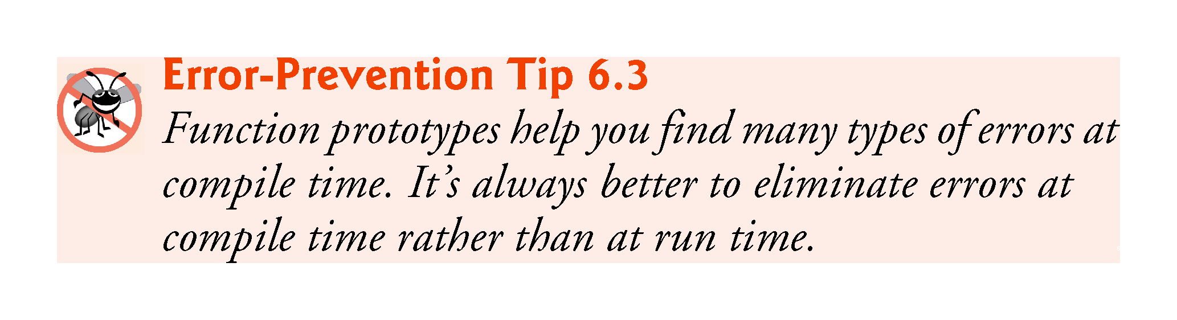

Slide 37
6.5.2 Argument Coercion
An important feature of function prototypes is argument coercion
forcing arguments to the appropriate types specified by the parameter declarations.
These conversions occur as specified by C++’s promotion rules.

Slide 38
6.5.3 Argument-Promotion Rules and Implicit Conversions
The promotion rules indicate how to convert between types without losing data.
The promotion rules apply to expressions containing values of two or more data types
also referred to as mixed-type expressions.
The type of each value in a mixed-type expression is promoted to the “highest” type in the expression.

Slide 39
6.5.3 Argument-Promotion Rules and Implicit Conversions
Figure 6.4 lists the arithmetic data types in order from “highest type” to “lowest type.”
Converting values to lower fundamental types can result in incorrect values.
Therefore, a value can be converted to a lower fundamental type only by explicitly assigning the value to a variable of lower type or by using a cast operator.

Slide 40
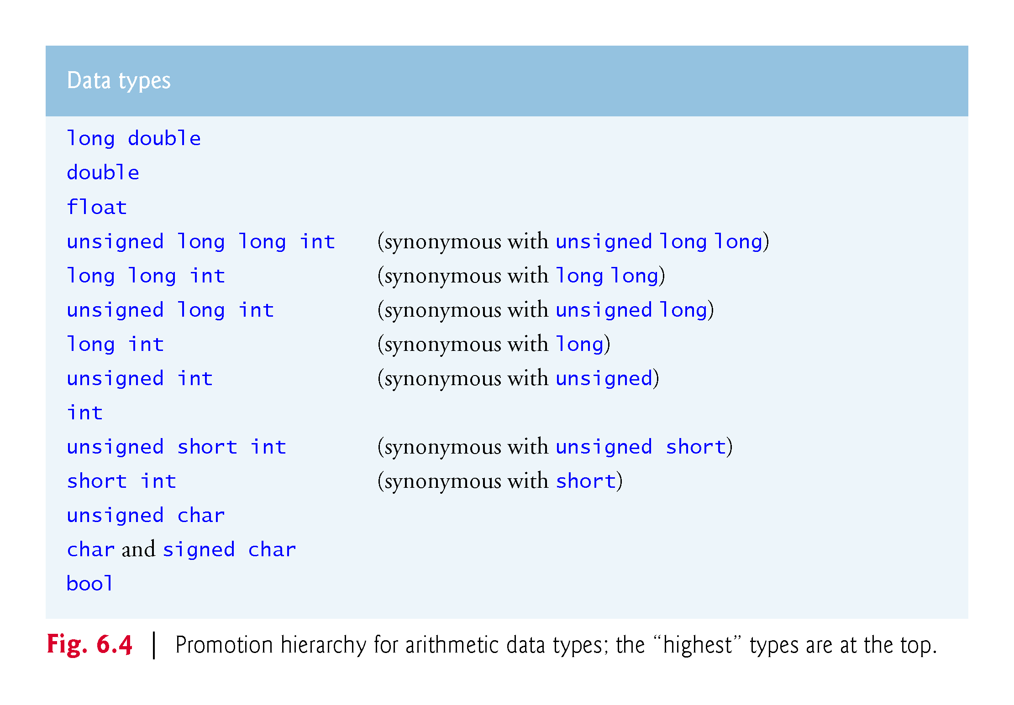

Slide 41
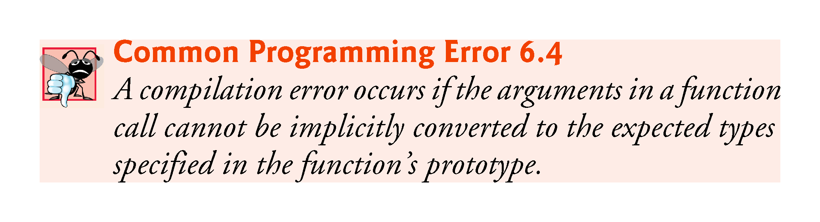

Slide 42
6.6 C++ Standard Library Header Files
The C++ Standard Library is divided into many portions, each with its own header file.
The header files contain the function prototypes for the related functions that form each portion of the library.
The header files also contain definitions of various class types and functions, as well as constants needed by those functions.
A header file “instructs” the compiler on how to interface with library and user-written components.
Figure 6.5 lists some common C++ Standard Library header files, most of which are discussed later in the book.

Slide 43
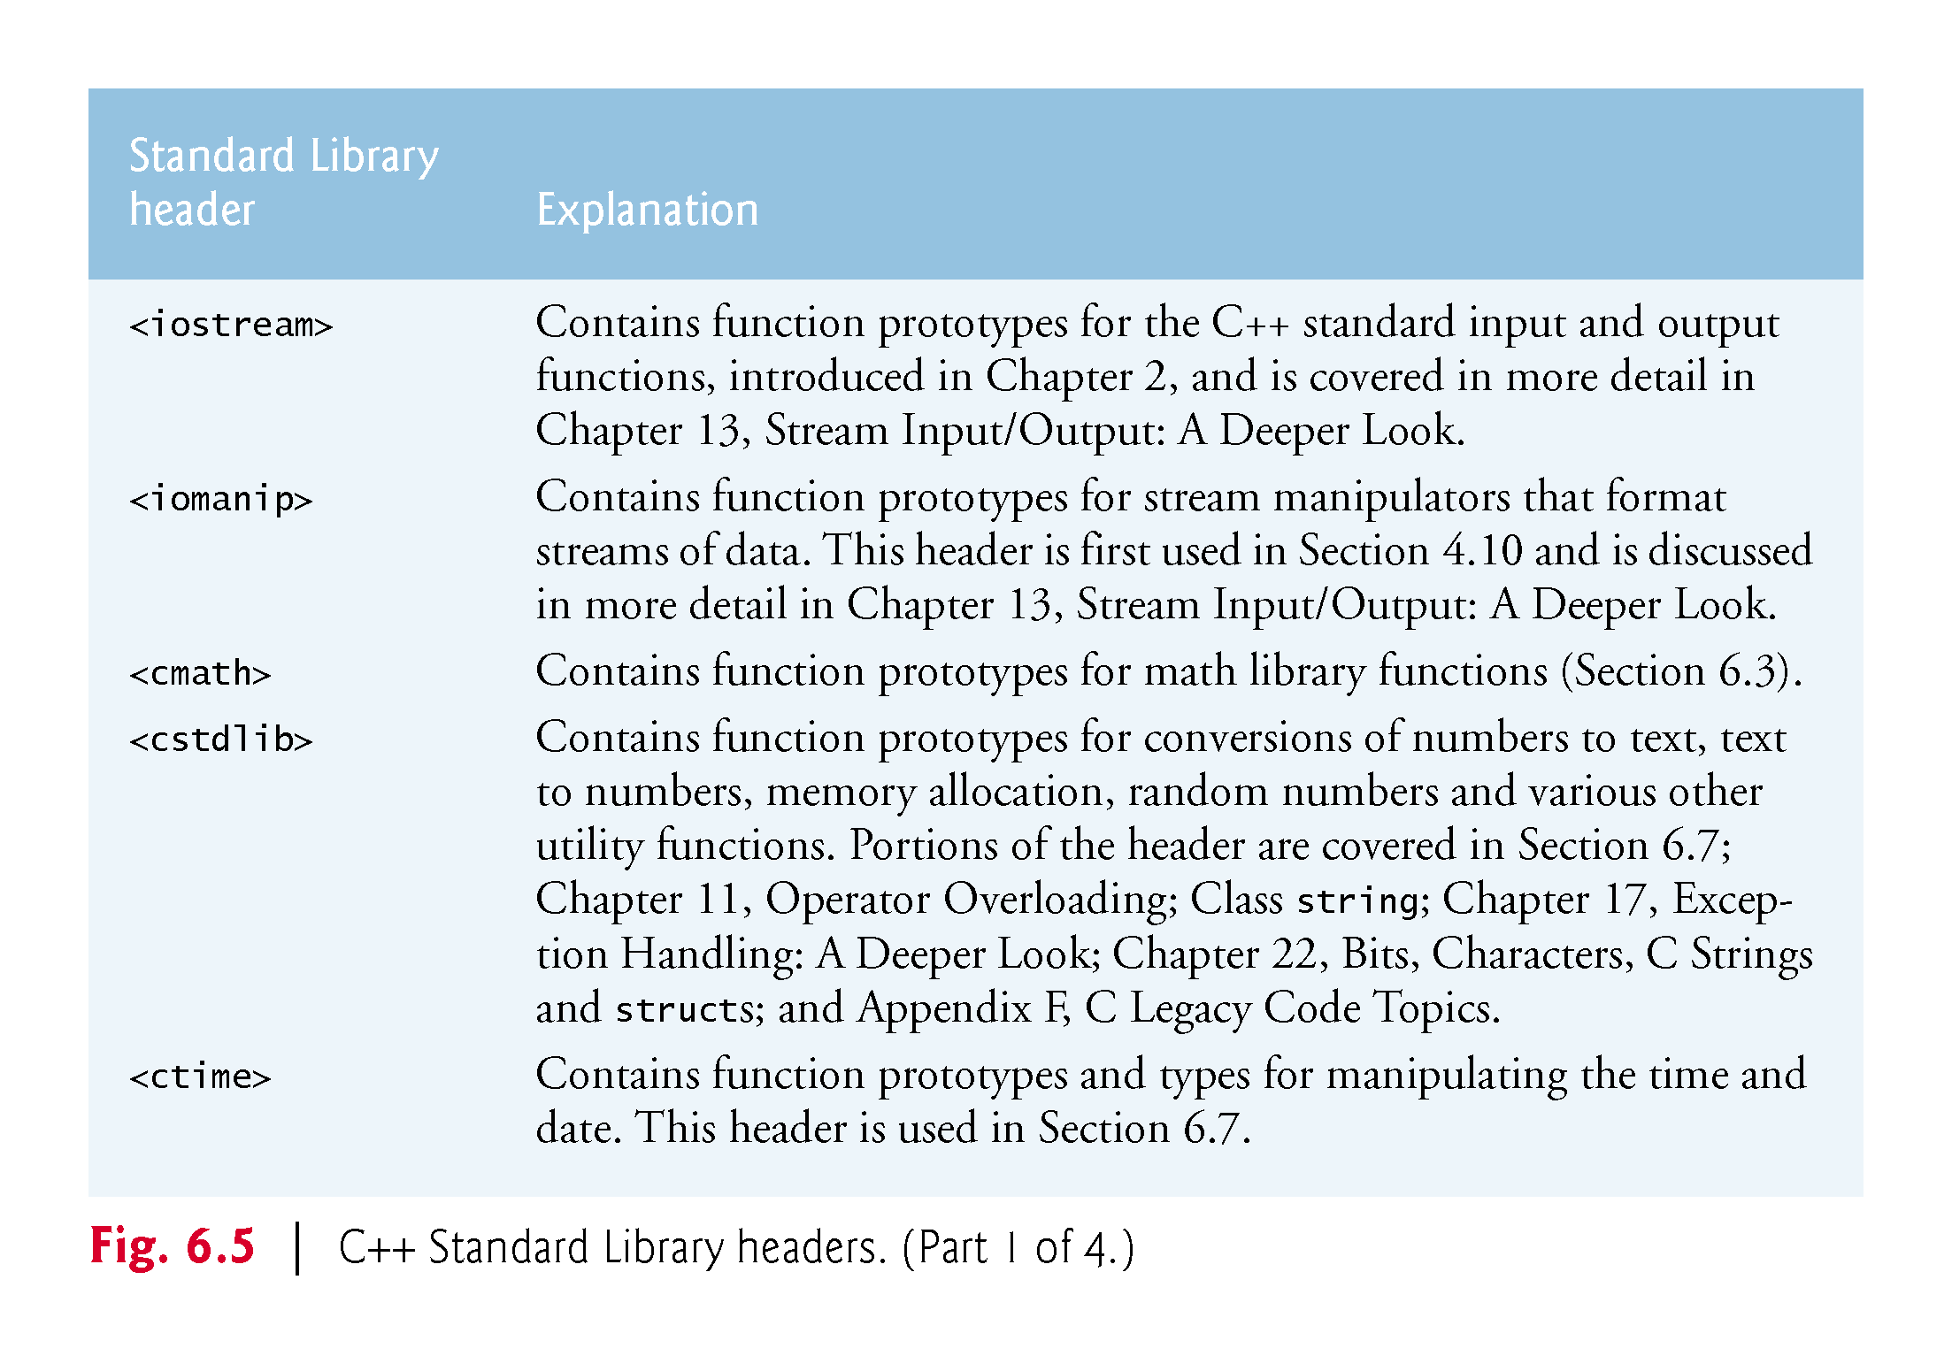

Slide 44
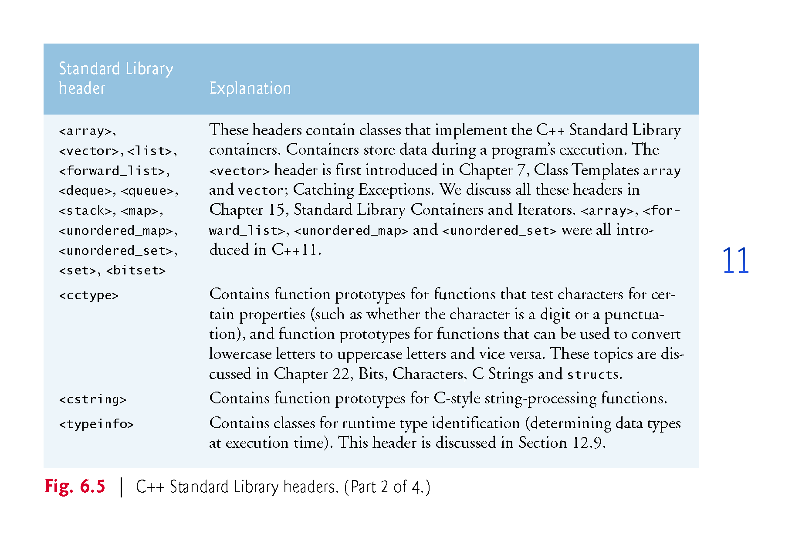

Slide 45
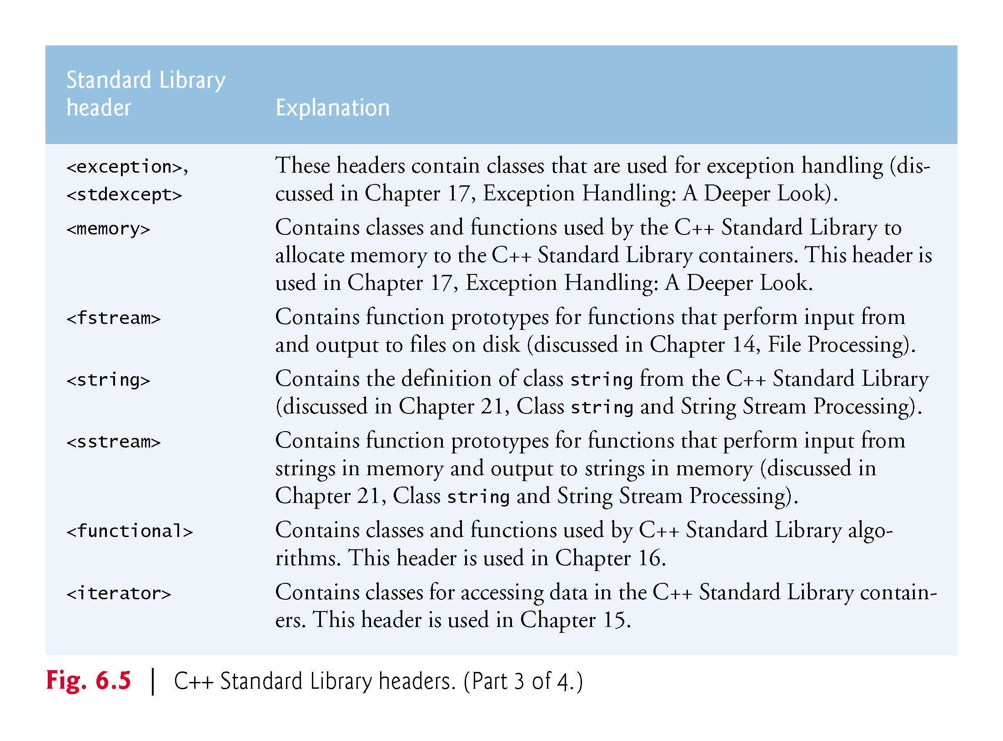

Slide 46
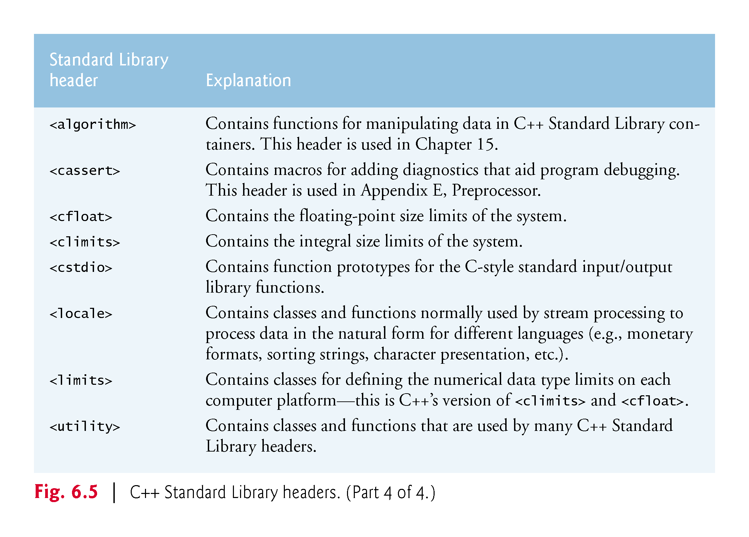

Slide 47
6.7 Case Study: Random Number Generation
The element of chance can be introduced into computer applications by using the C++ Standard Library function rand.
The function rand generates an unsigned integer between 0 and RAND_MAX (a symbolic constant defined in the <cstdlib> header file).

Slide 48
6.7 Case Study: Random Number Generation
The value of RAND_MAX must be at least 32767—the maximum positive value for a two-byte (16-bit) integer.
For GNU C++, the value of RAND_MAX is 2147483647; for Visual Studio, the value of RAND_MAX is 32767.
If rand truly produces integers at random, every number between 0 and RAND_MAX has an equal chance (or probability) of being chosen each time rand is called.

Slide 49
6.7.1 Rolling a Six-Sided Die
The function prototype for the rand function is in <cstdlib>.
To produce integers in the range 0 to 5, we use the modulus operator (%) with rand:
rand() % 6
This is called scaling.
The number 6 is called the scaling factor. Six values are produced.
We can shift the range of numbers produced by adding a value.

Slide 50
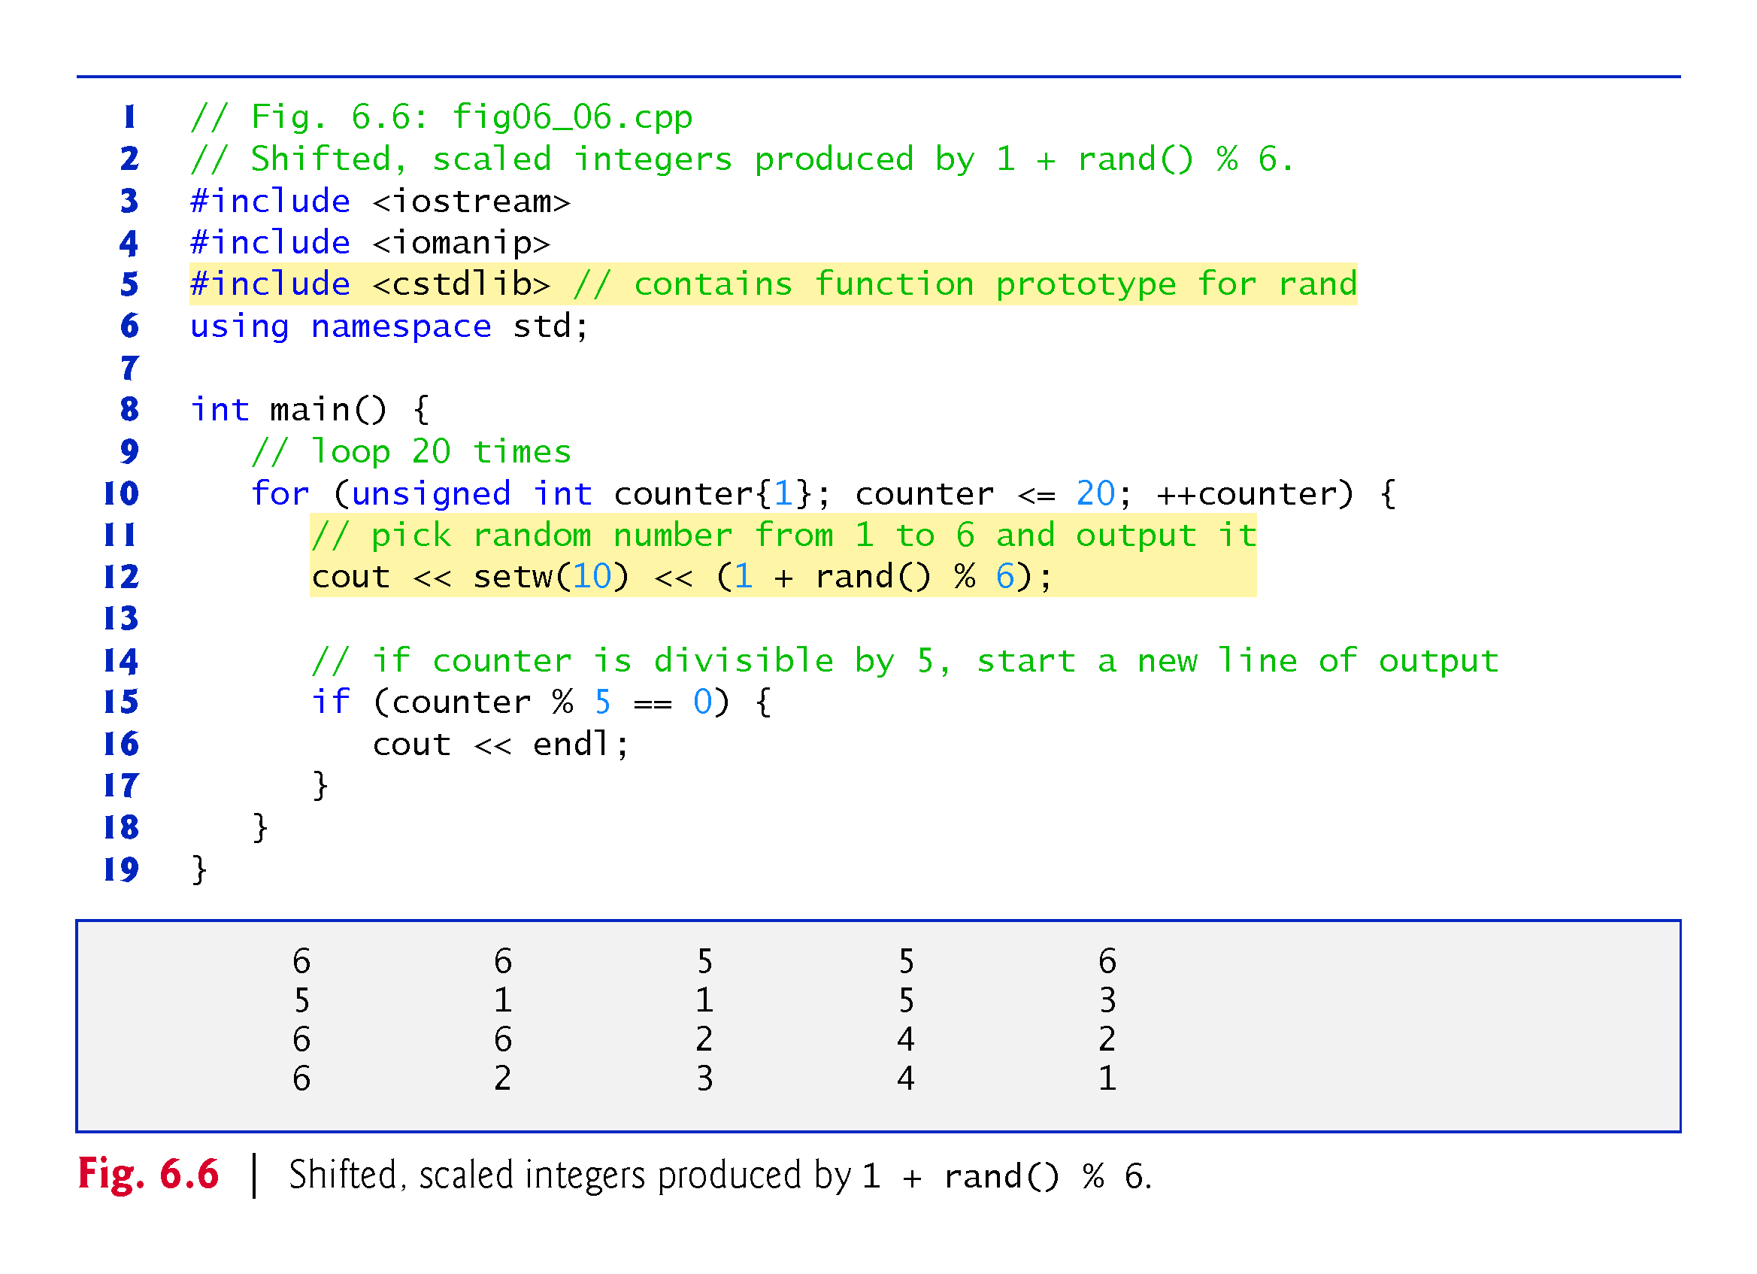

Slide 51
6.7.2 Rolling a Six-Sided Die 60,000,000 Times
To show that the numbers produced by rand occur with approximately equal likelihood, Fig. 6.7 simulates 60,000,000 rolls of a die.
Each integer in the range 1 to 6 should appear approximately 10ccccc,000,000 times.

Slide 52
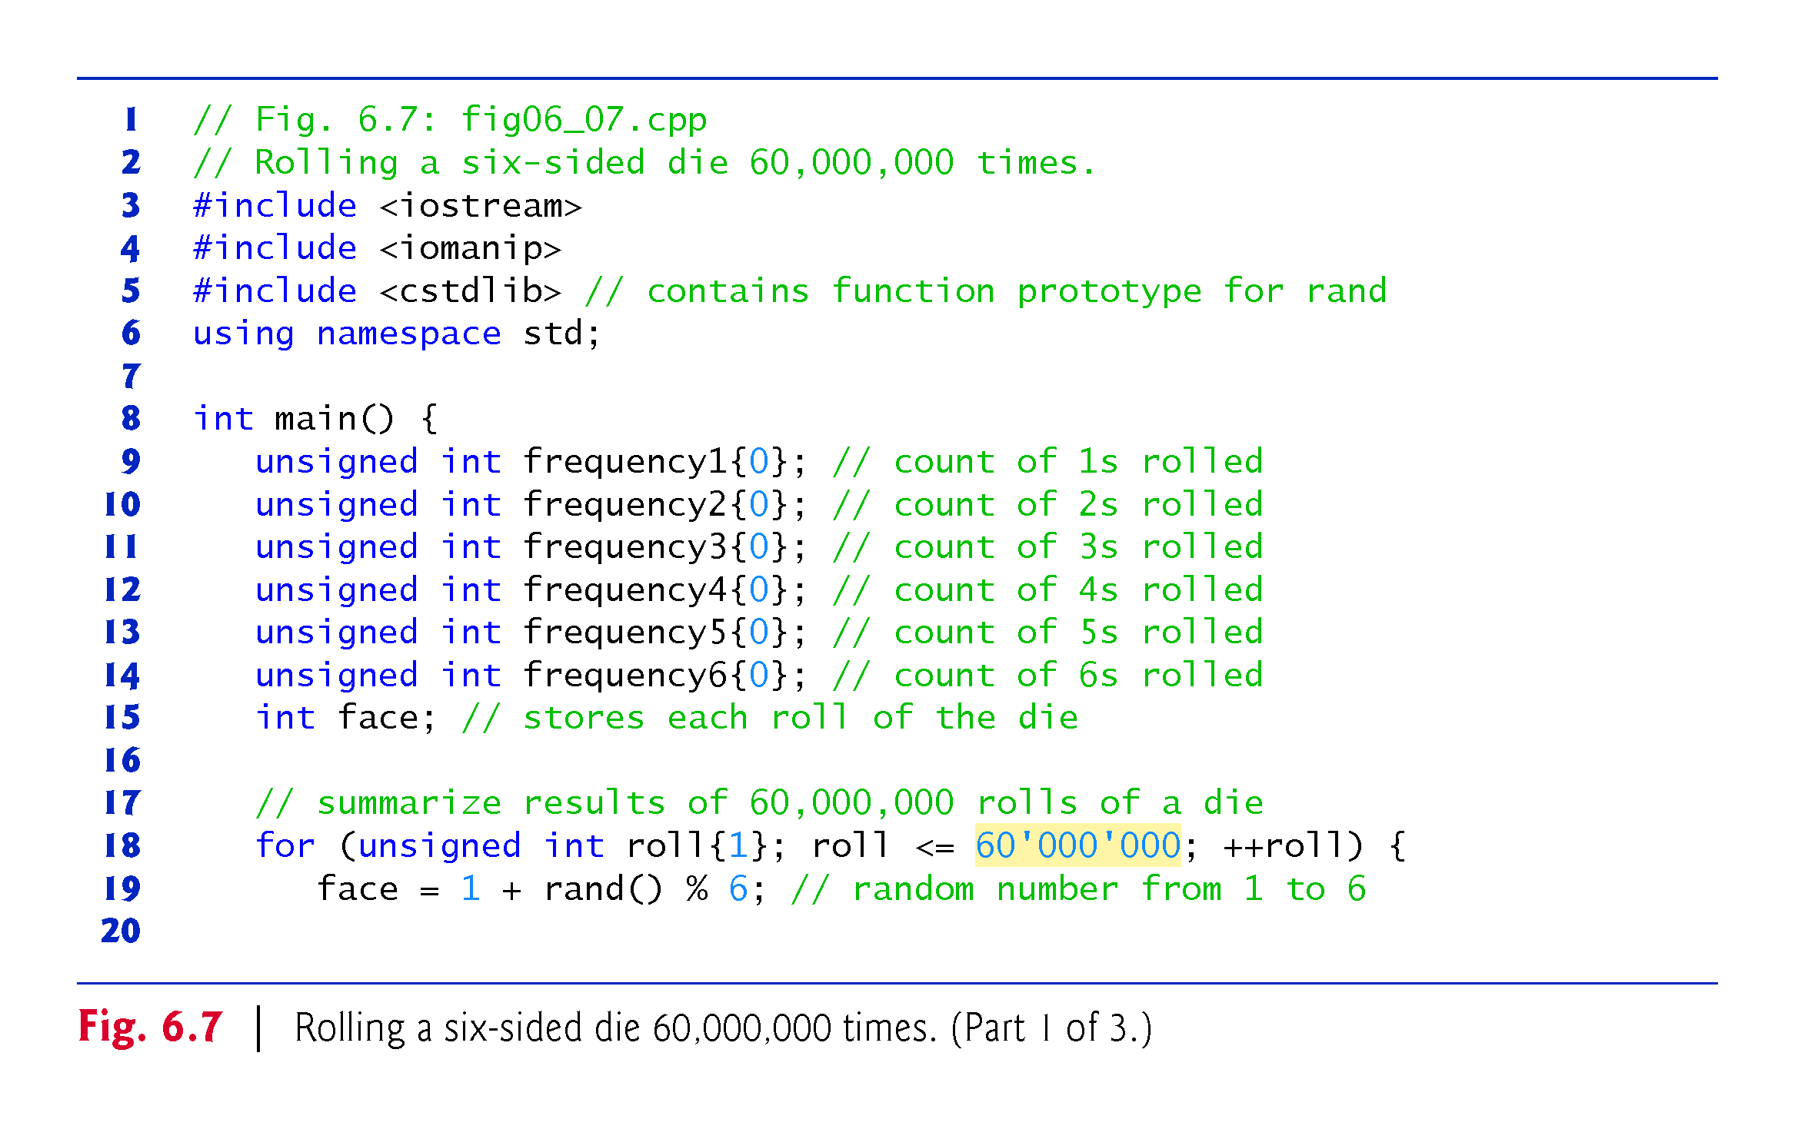

Slide 53
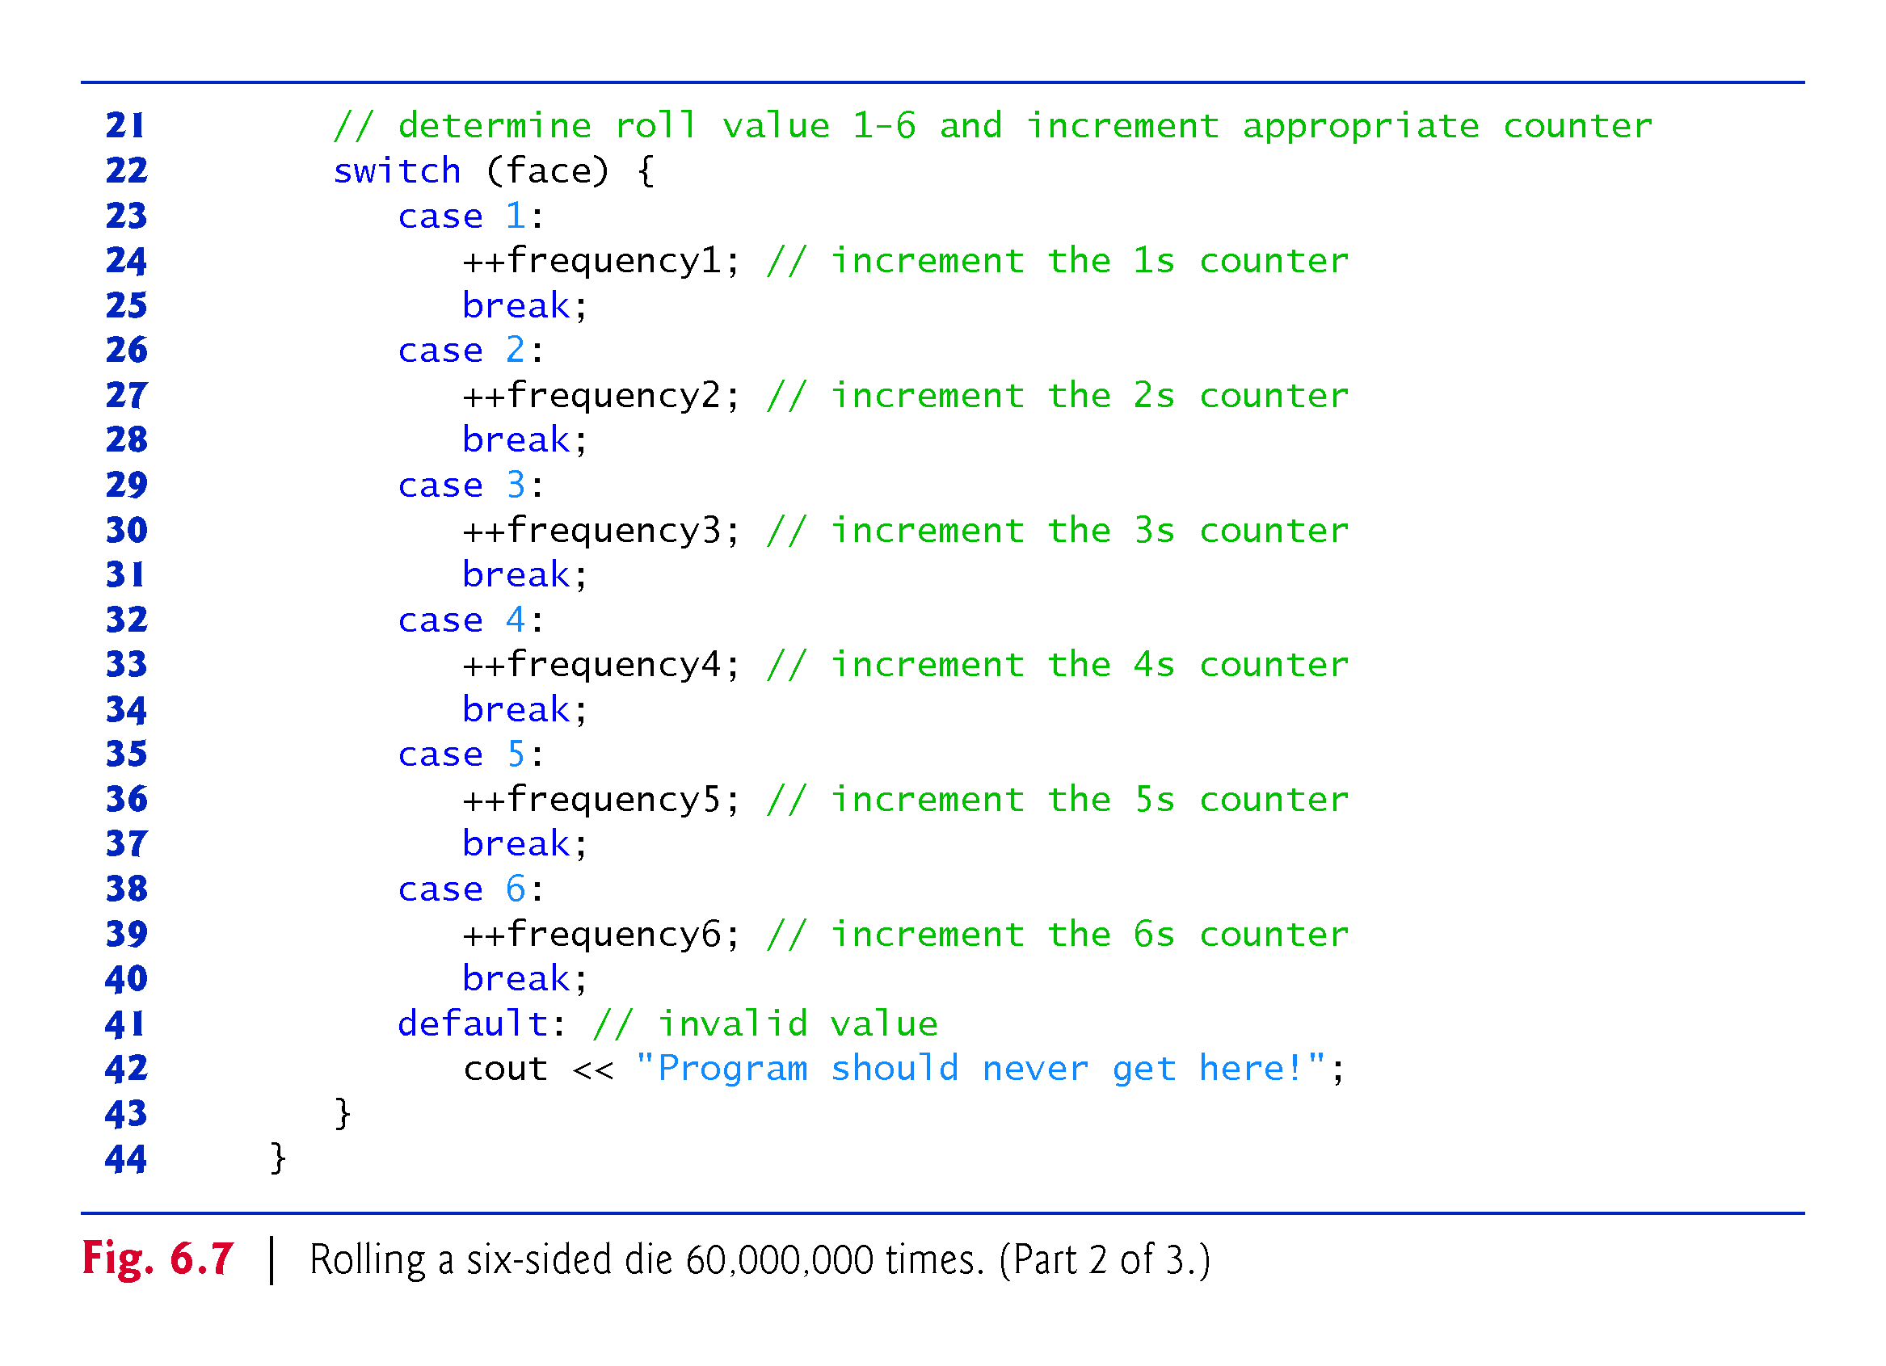

Slide 54
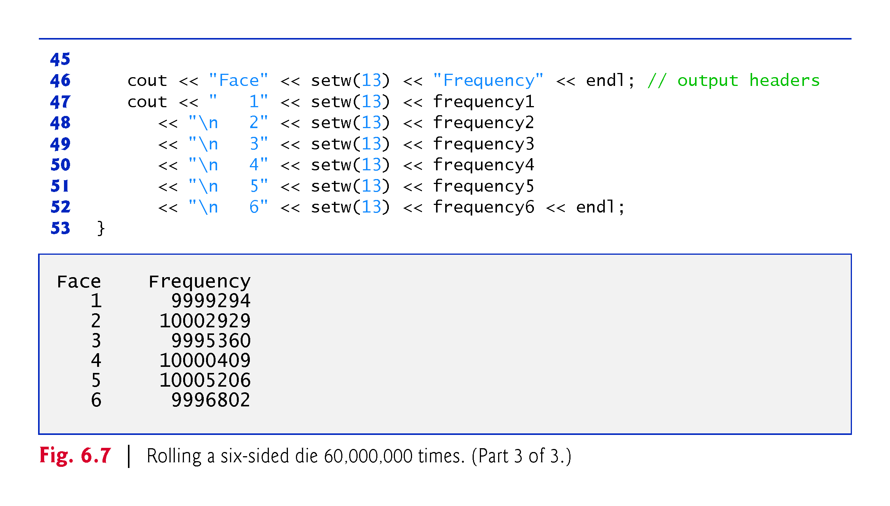

Slide 55
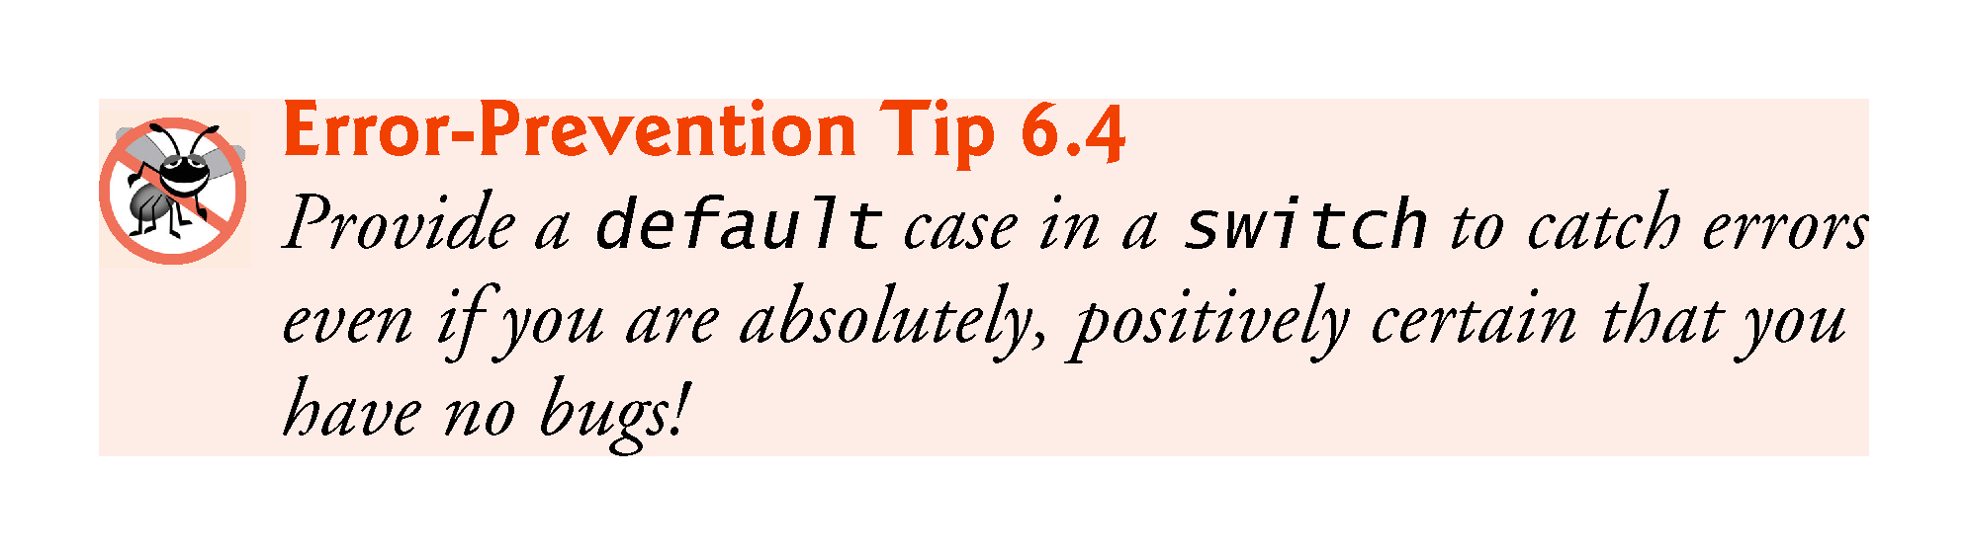

Slide 56
6.7.2 Rolling a Six-Sided Die 60,000,000 Times
Prior to C++14, you’d represent the integer value 60,000,000 as 60000000 in a program.
To make numeric literals more readable, C++14 allows you to insert between groups of digits in numeric literals the digit separator ' (a single-quote character)
60'000'000 represents the integer value 60,000,000.

Slide 57
6.7.3 Randomizing the Random-Number Generator with srand
Executing the program of Fig. 6.6 again produces exactly the same sequence of values.
Repeatability is an important characteristic of rand.
Can help with testing and debugging.
rand generates pseudorandom numbers.
a sequence of numbers that appears to be random.
sequence repeats itself each time the program executes.

Slide 58
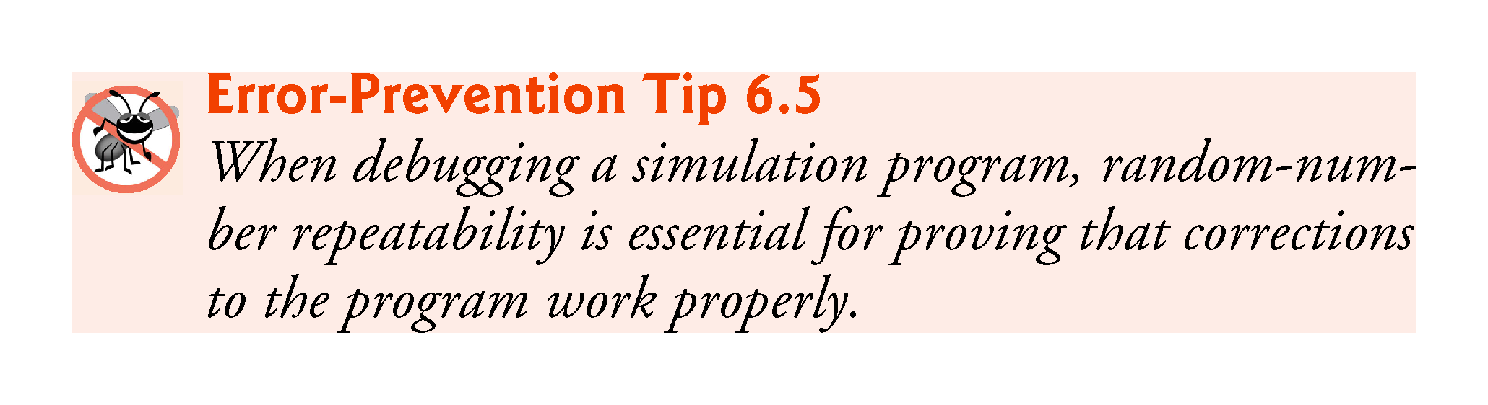

Slide 59
6.7.3 Randomizing the Random-Number Generator with srand
Once a program has been debugged, it can be conditioned to produce a different sequence of random numbers for each execution.
This is called randomizing and is accomplished with the C++ Standard Library function srand.
Takes an unsigned integer argument and seeds rand to produce a different sequence of random numbers for each execution.

Slide 60
6.7 Case Study: Random Number Generation (cont.)
Seeding the Random Number Generator with srand
Figure 6.8 demonstrates function srand.

Slide 61
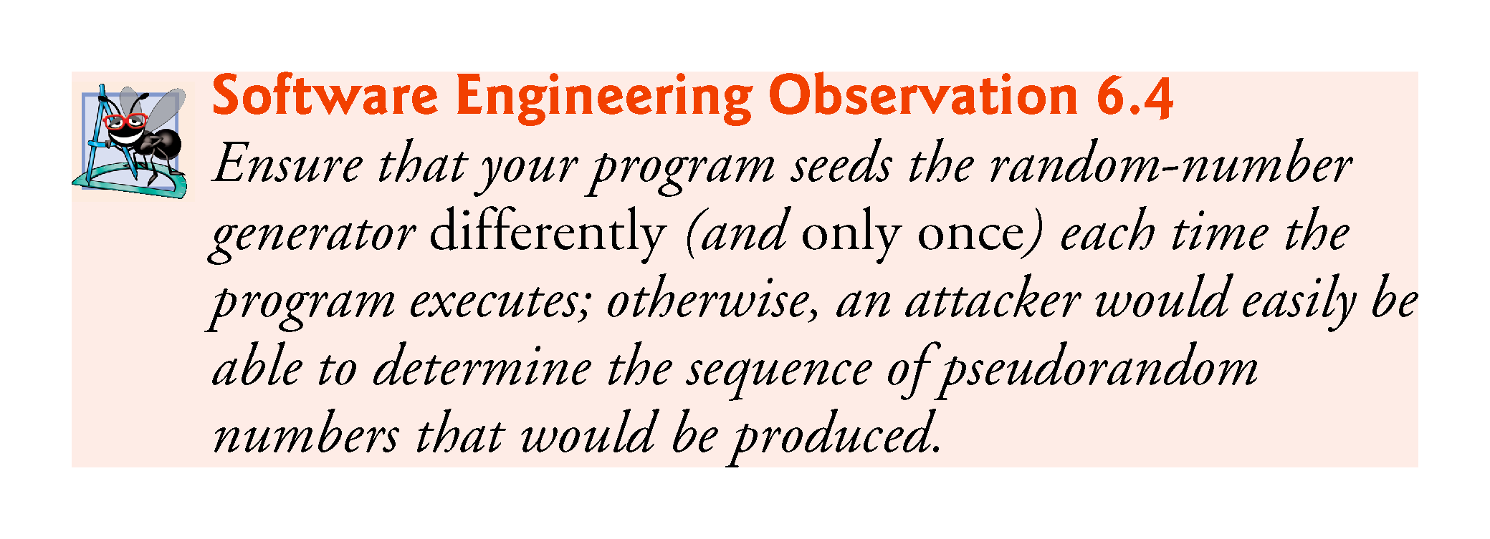

Slide 62
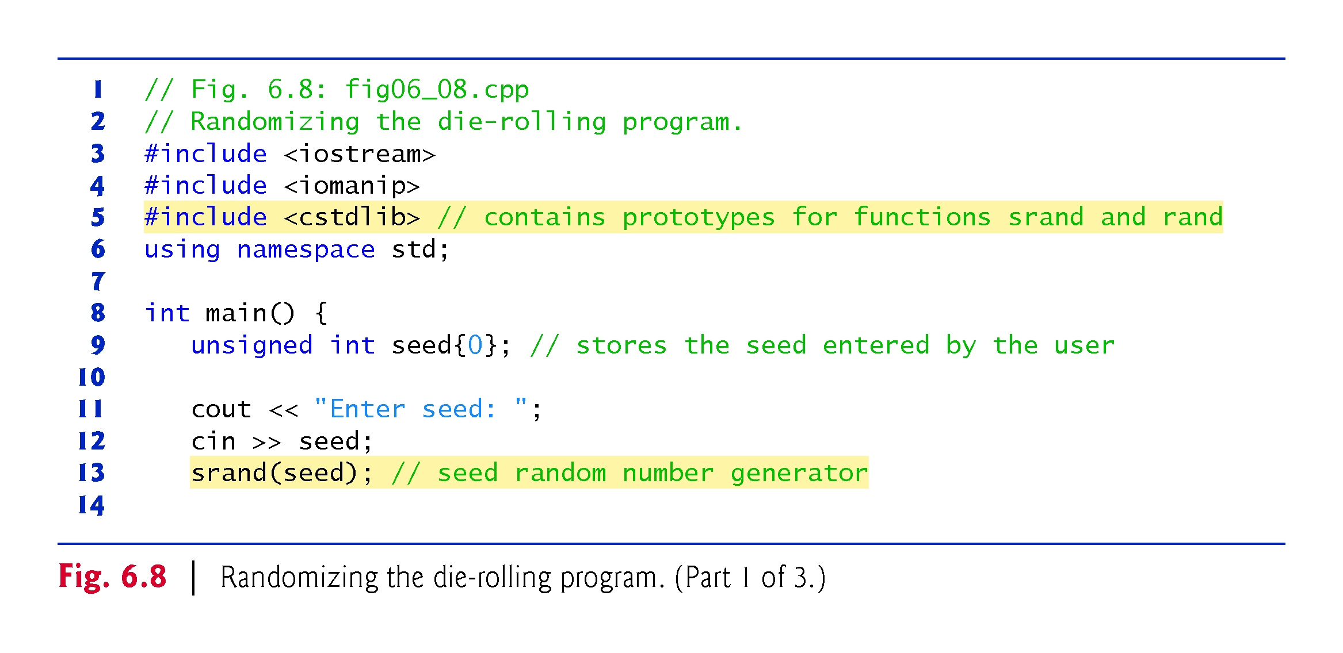

Slide 63
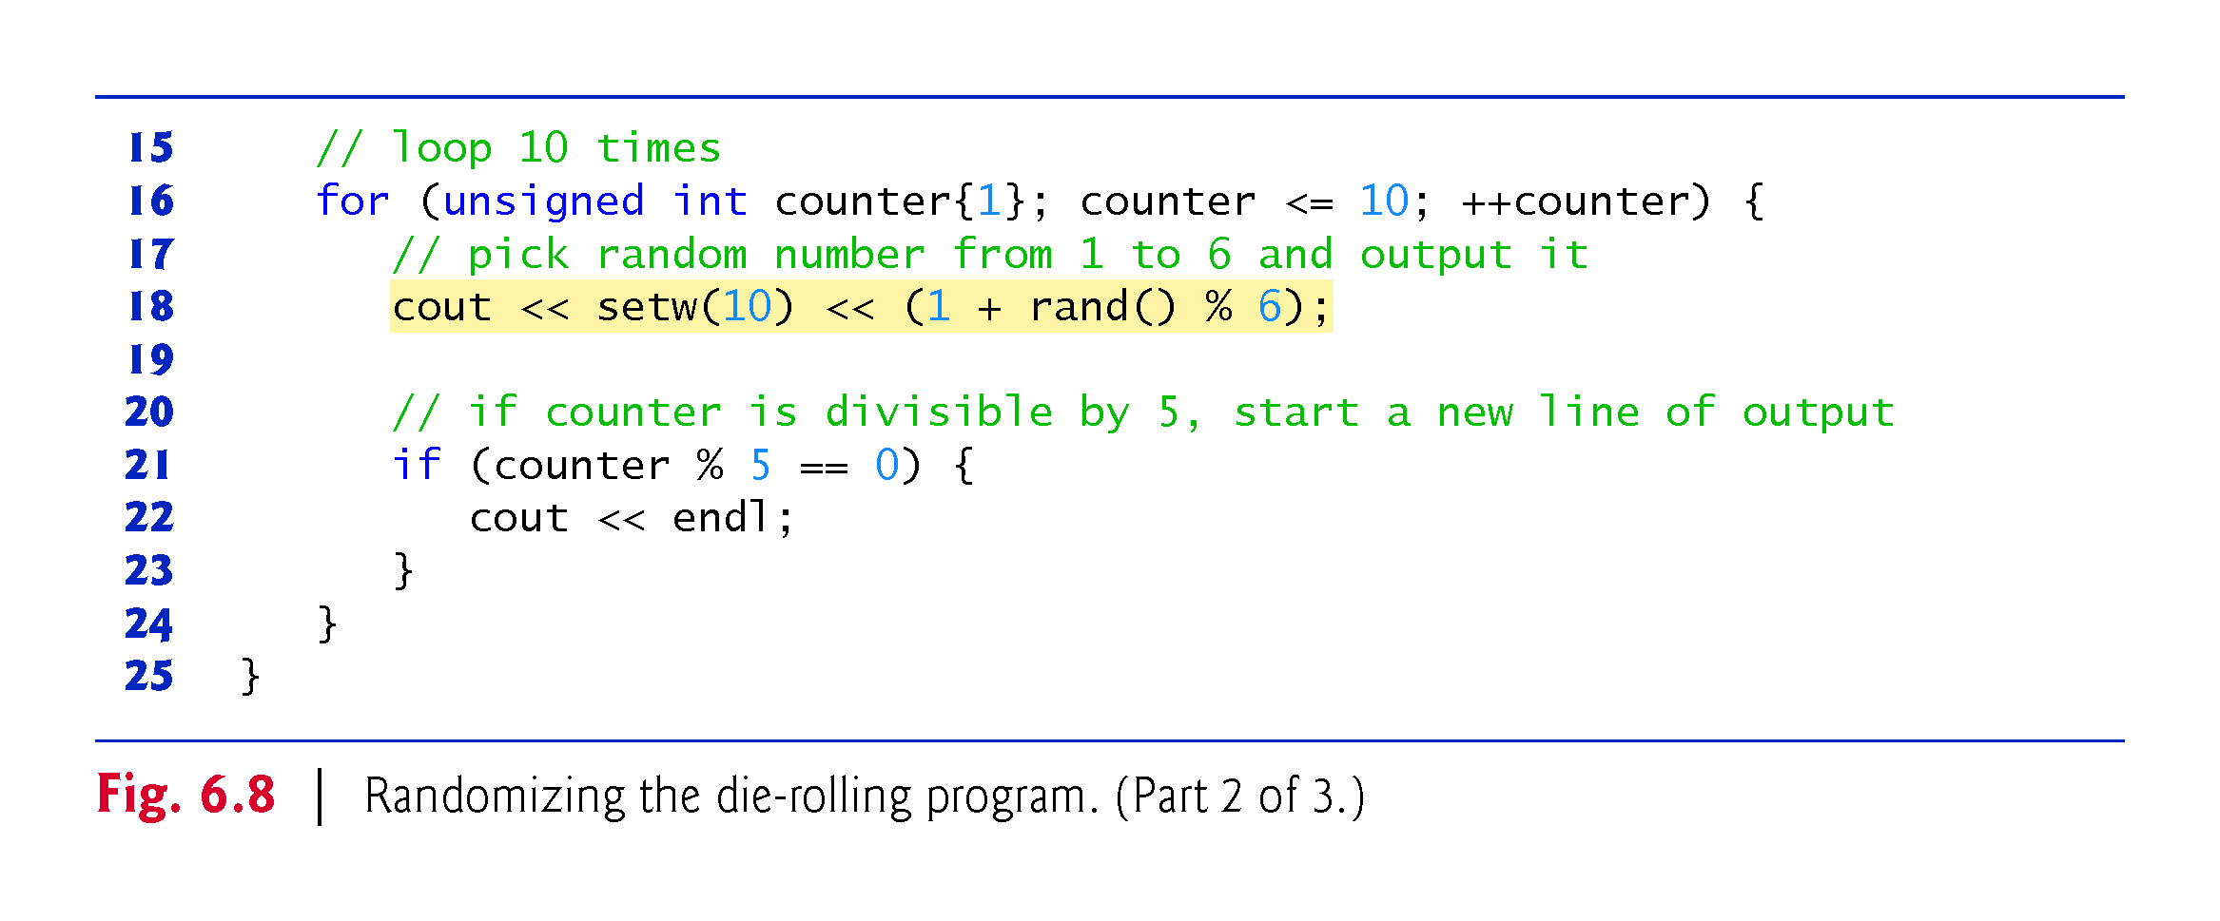

Slide 64
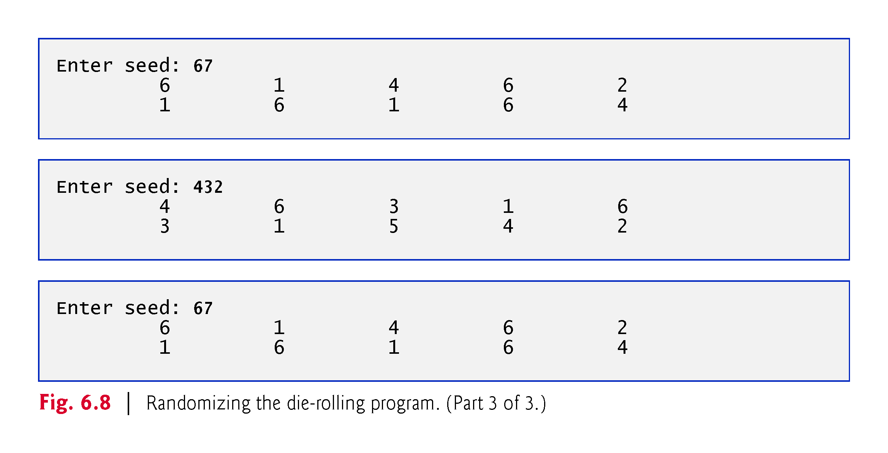

Slide 65
6.7.4 Seeding the Random-Number Generator with the Current Time
To randomize without having to enter a seed
srand(static_cast<unsigned int>(time(0)));
Causes the computer to read its clock to obtain the value for the seed.
Function time (with the argument 0 as written in the preceding statement) returns the current time as the number of seconds since January 1, 1970, at midnight Greenwich Mean Time (GMT).
The function prototype for time is in <ctime>.

Slide 66
6.7.5 Scaling and Shifting Random Numbers
To produce random numbers in a specific range use:
type variableName = shiftingValue + rand() % scalingFactor;
shiftingValue is equal to the first number in the desired range of consecutive integers
scalingFactor is equal to the width of the de-sired range of consecutive integers.

Slide 67
6.8 Case Study: Game of Chance; Introducing enum
Rules of Craps
A player rolls two dice. Each die has six faces.
Faces contain 1, 2, 3, 4, 5 and 6 spots.
After the dice have come to rest, the sum of the spots on the two upward faces is calculated.
If the sum is 7 or 11 on the first roll, the player wins.
If the sum is 2, 3 or 12 on the first roll (called “craps”), the player loses (i.e., the “house” wins).
If the sum is 4, 5, 6, 8, 9 or 10 on the first roll, then that sum becomes the player’s “point.”
To win, continue rolling until you “make your point.”
You lose by rolling a 7 before making the point.
The program in Fig. 6.9 simulates the game.

Slide 68
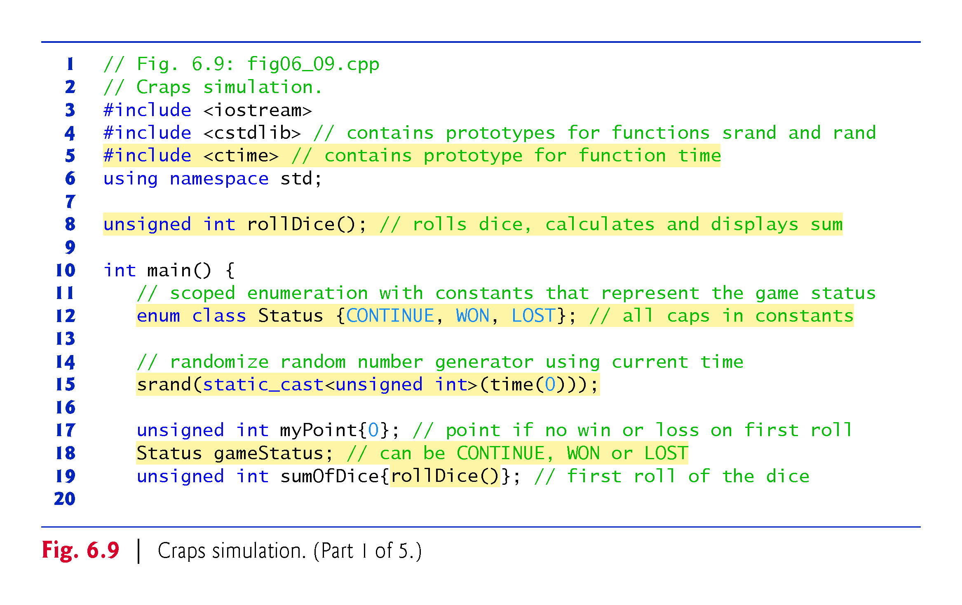

Slide 69
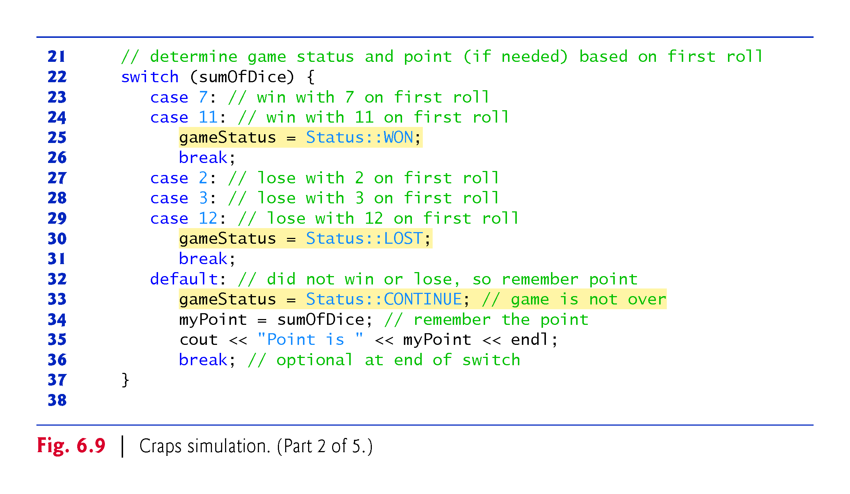

Slide 70
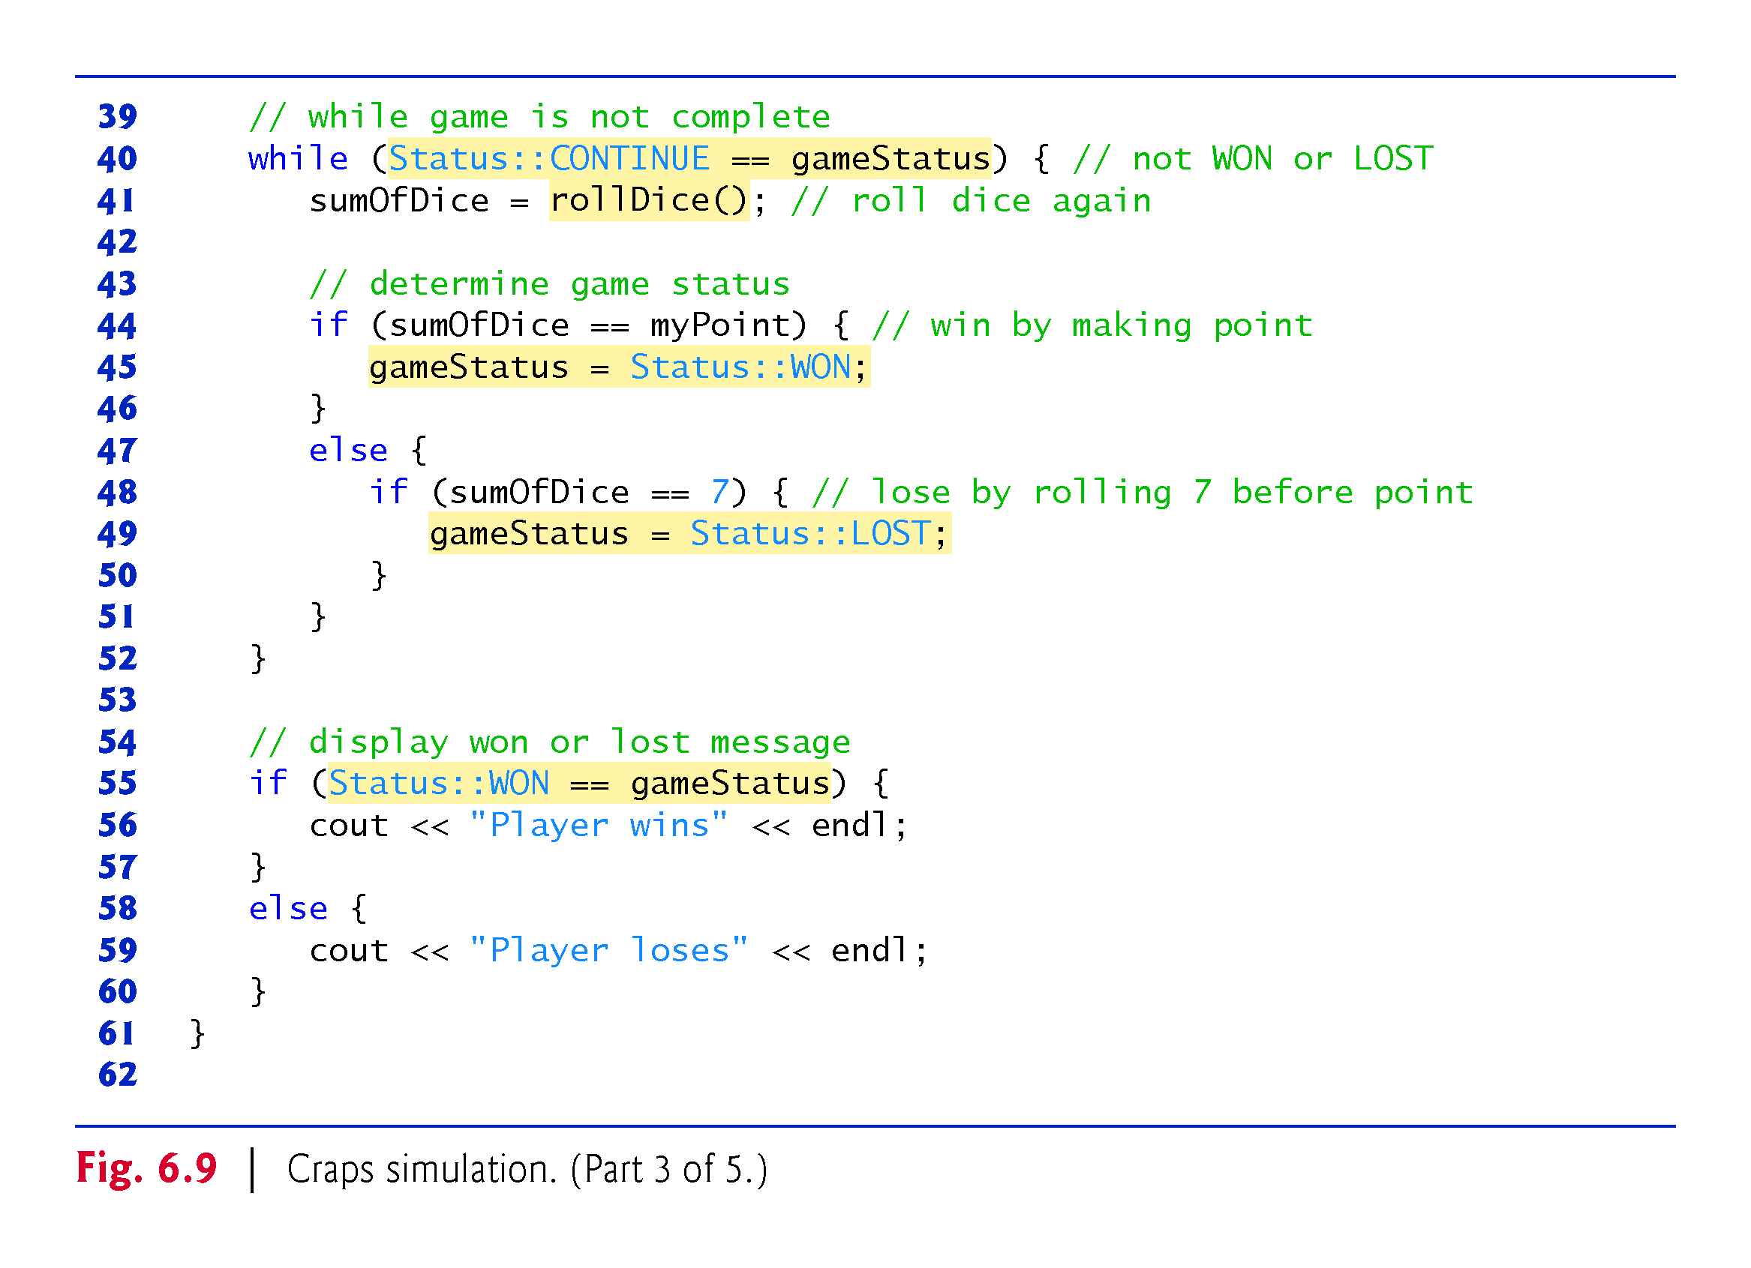

Slide 71
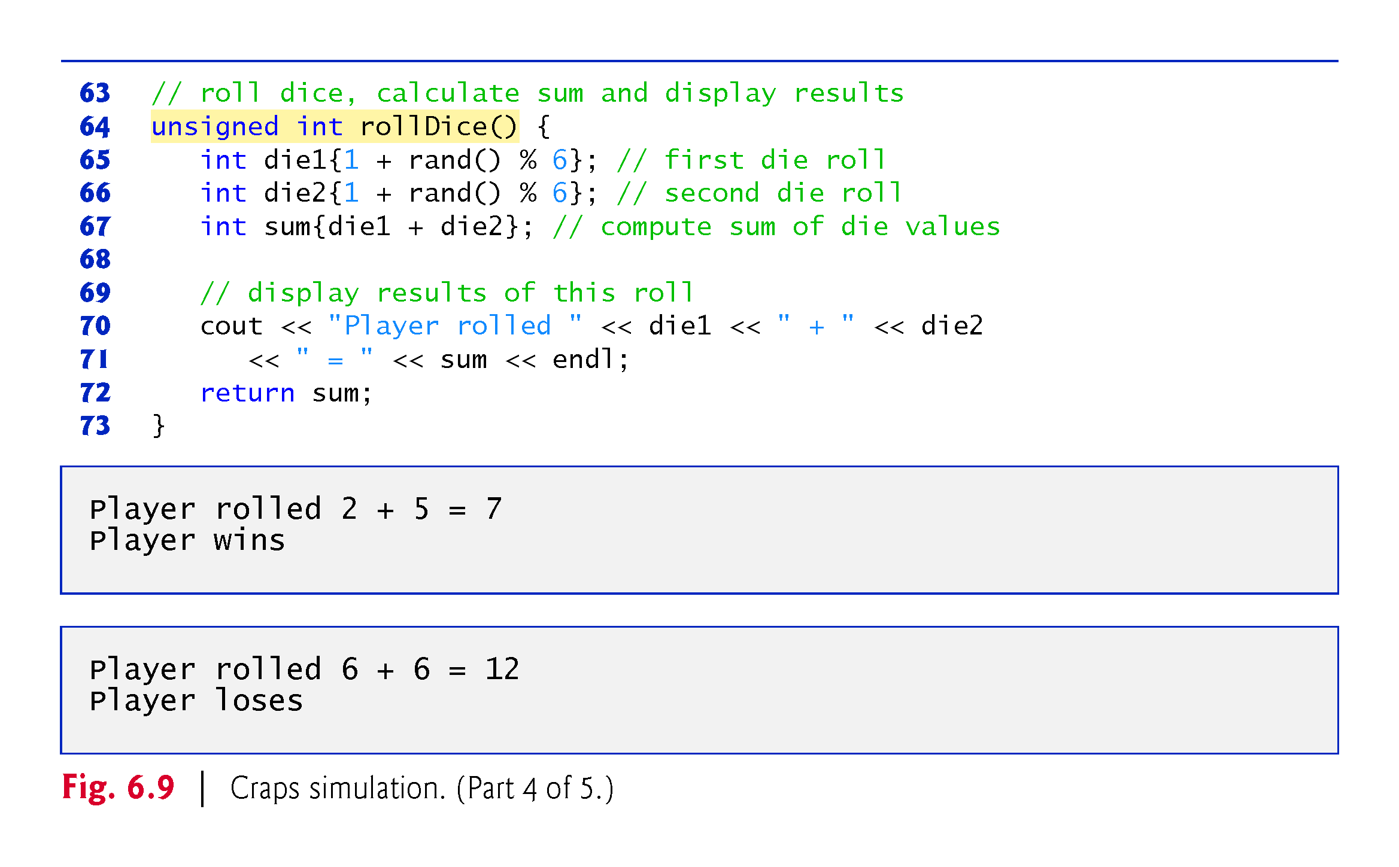

Slide 72
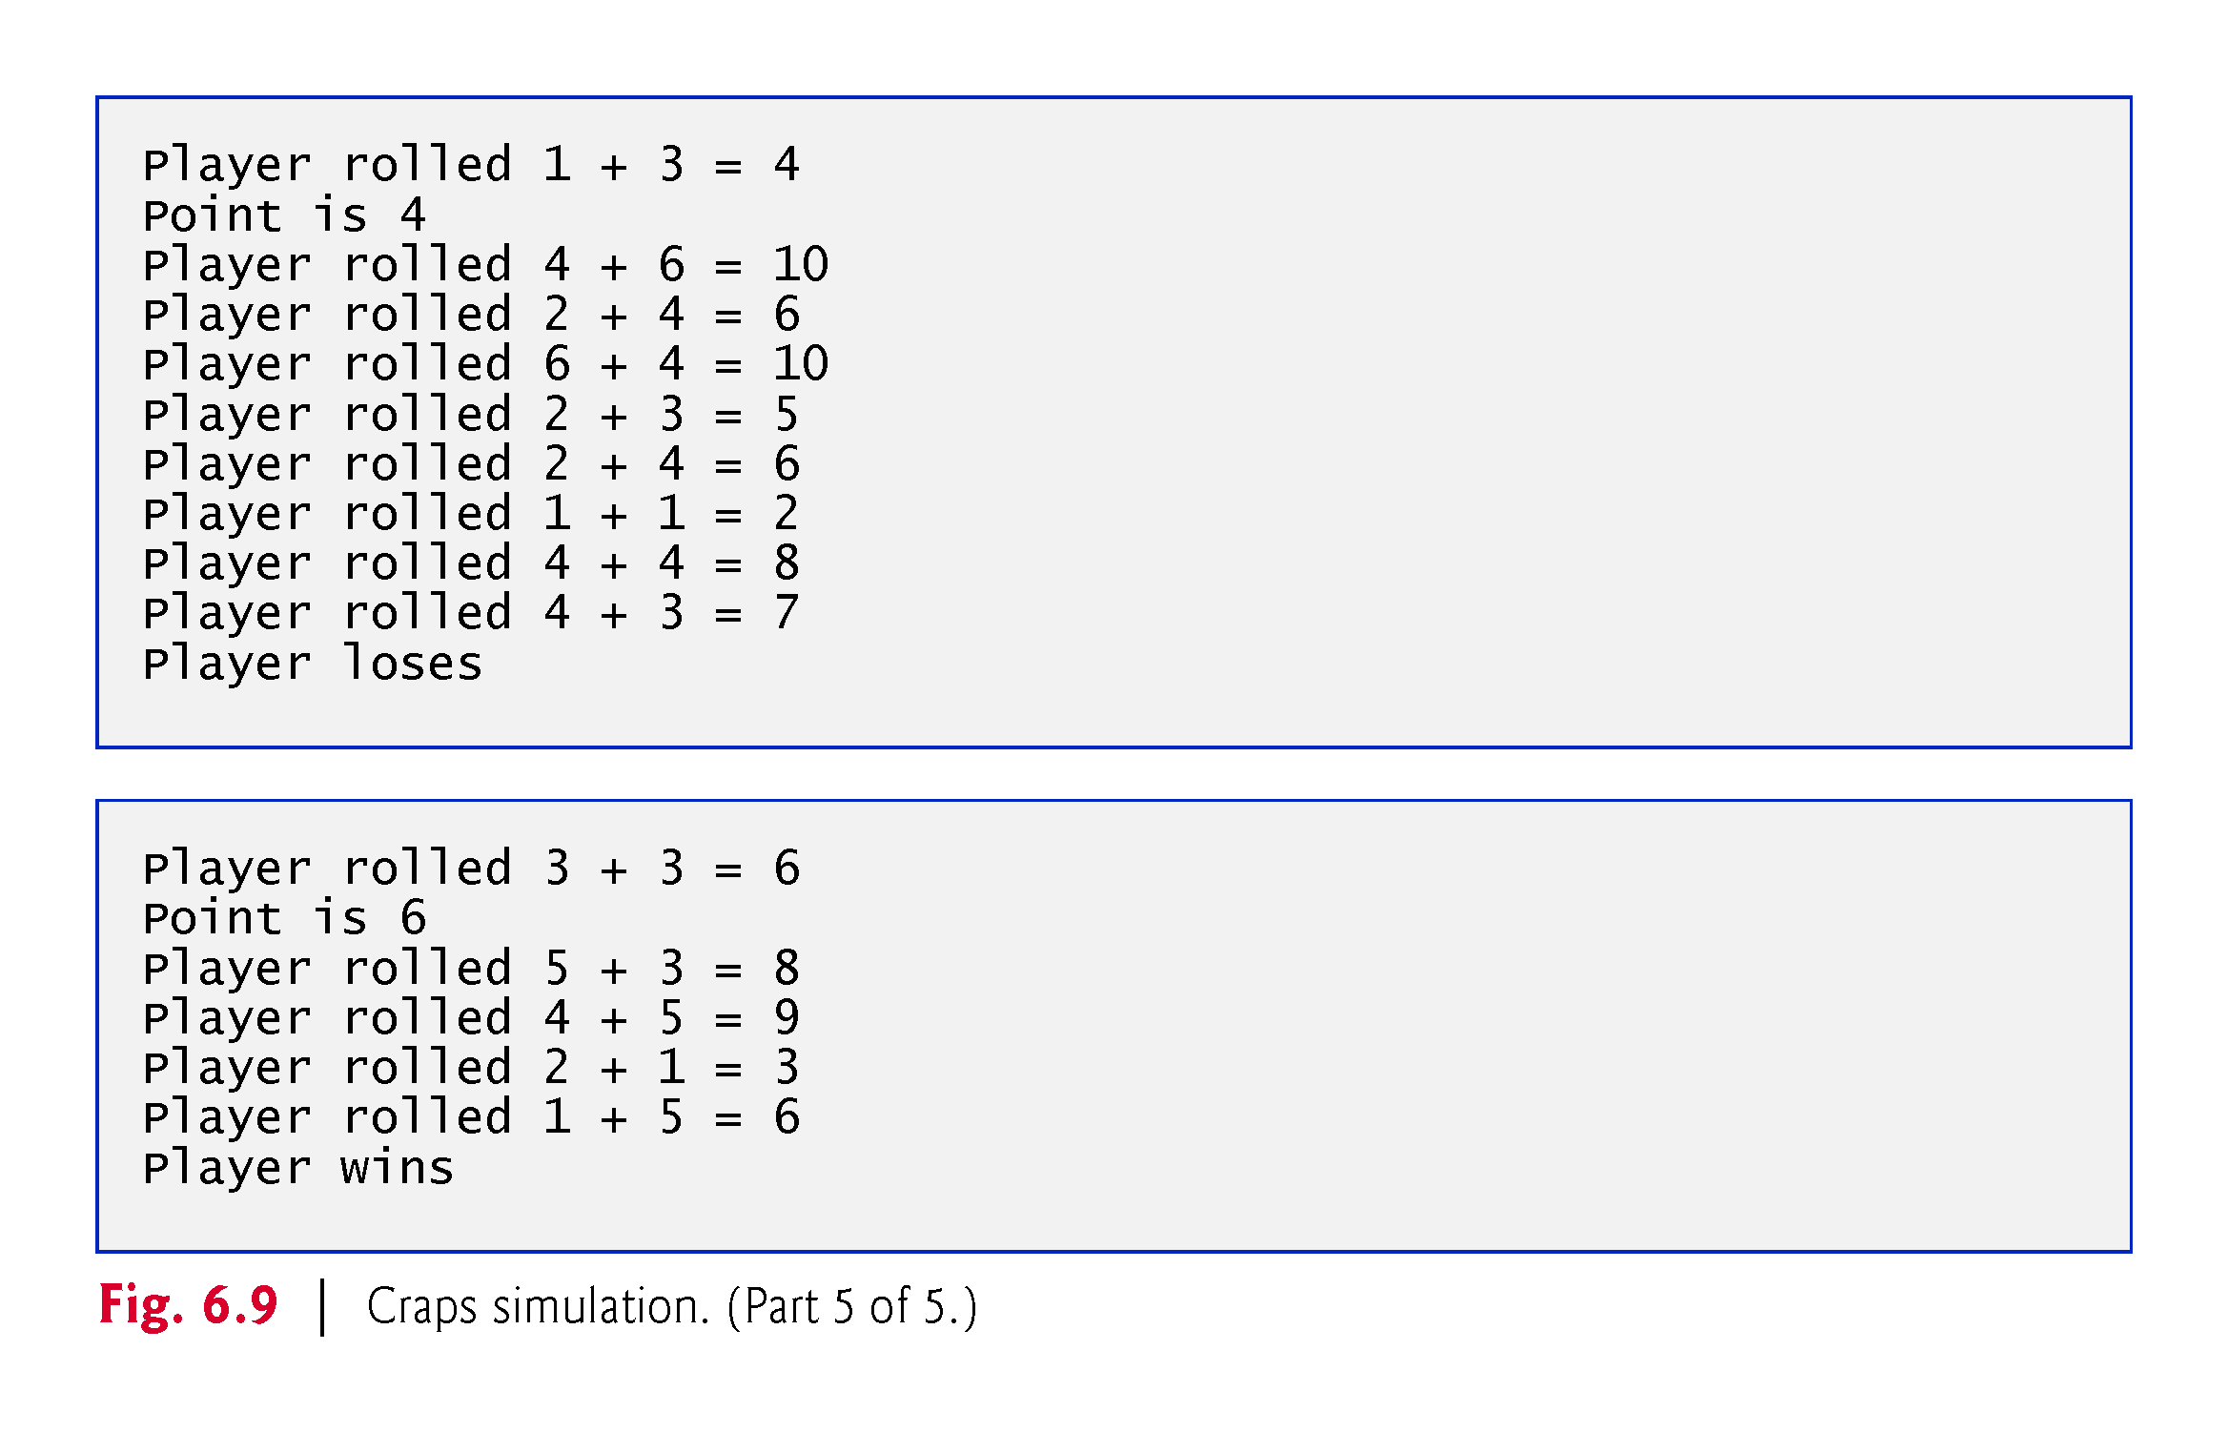

Slide 73
6.8 Case Study: Game of Chance; Introducing enum (cont.)
A scoped enumeration (C++11) introduced by enum class and followed by a type name, is a set of identifiers representing integer constants.
The values of these enumeration constants start at 0, unless specified otherwise, and increment by 1.
The identifiers must be unique, but separate enumeration constants can have the same value.
Variables of an enum class can be assigned only one of the values declared in the enumeration.

Slide 74
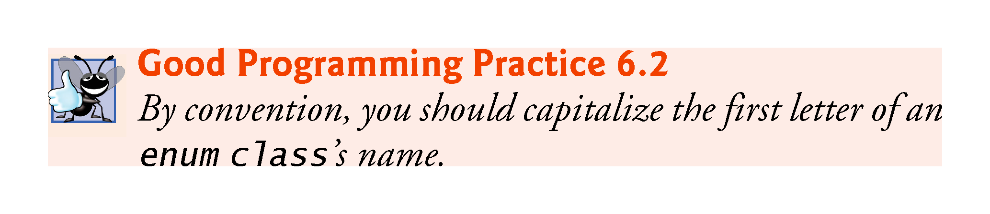

Slide 75
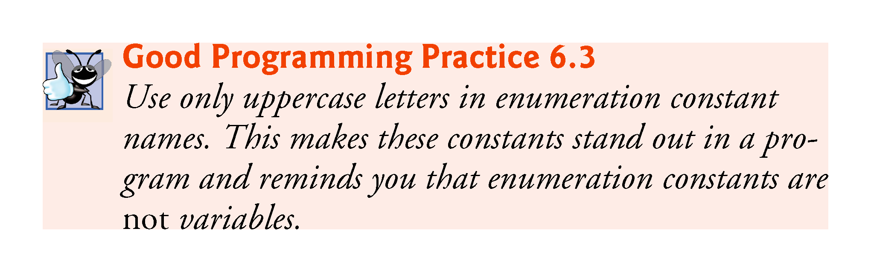

Slide 76
6.8 Case Study: Game of Chance; Introducing enum (cont.)
To reference a scoped enum constant, qualify it with the type name and the scope-resolution operator (::), as in Status::CONTINUE.

Slide 77
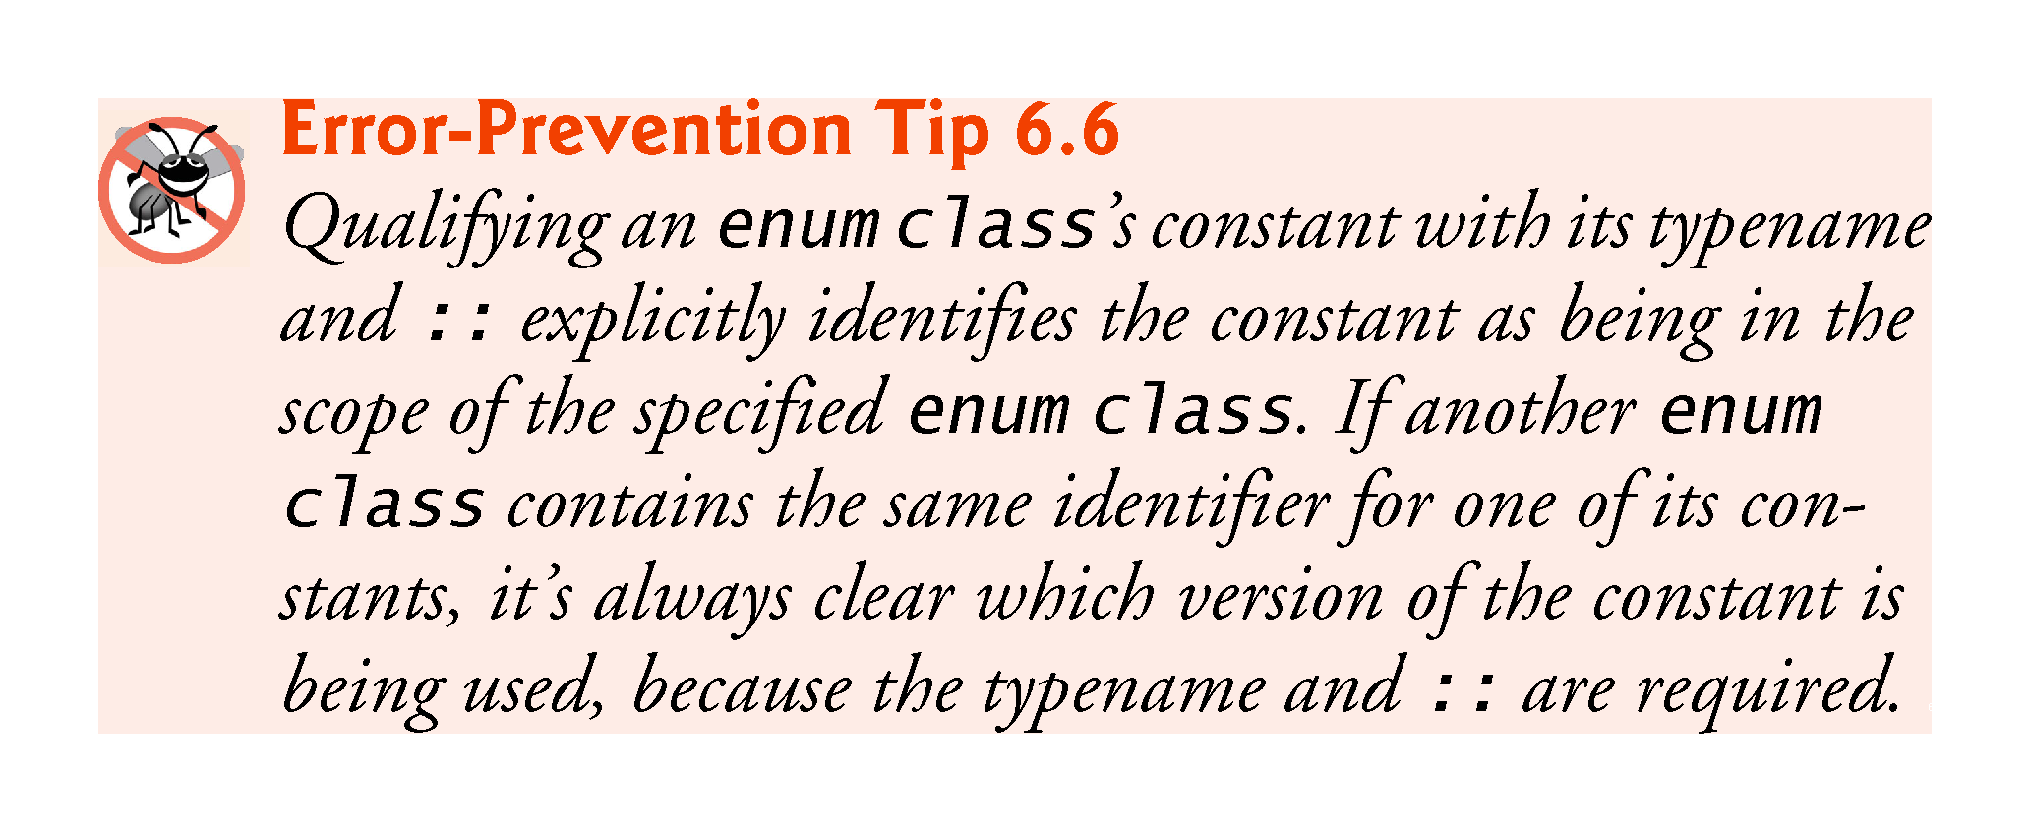

Slide 78
6.8 Case Study: Game of Chance; Introducing enum (cont.)
Another popular enumeration is
enum class Months { JAN = 1, FEB, MAR, APR, MAY, JUN, JUL, AUG, SEP, OCT, NOV, DEC };
creates user-defined type Months with enumeration constants representing the months of the year.
The first value in the preceding enumeration is explicitly set to 1, so the remaining values increment from 1, resulting in the values 1 through 12.
Any enumeration constant can be assigned an integer value in the enumeration definition.

Slide 79
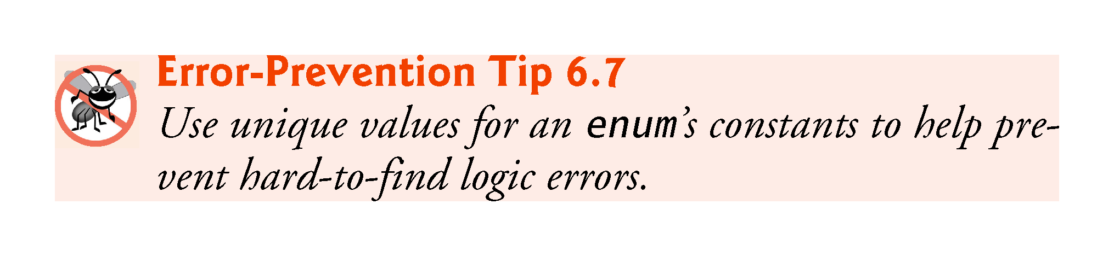

Slide 80
6.8 Case Study: Game of Chance; Introducing enum (cont.)
Prior to C++11, enumerations were defined with enum (unscoped enums)
Problem: multiple enums may contain the same identifiers.
Using such enums in the same program can lead to naming collisions and logic errors.

Slide 81
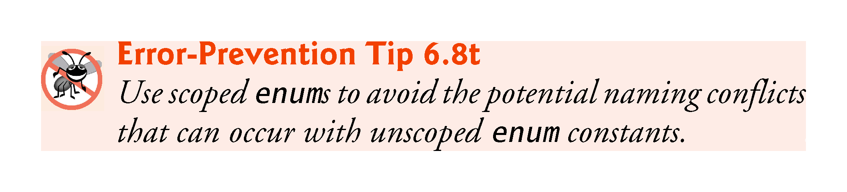

Slide 82
6.8 Case Study: Game of Chance; Introducing enum (cont.)
Enumeration constants are represented as integers.
An unscoped enum’s underlying integral type depends on its constants’ values—the type is guaranteed to be large enough to store the constant values specified.
A scoped enum’s underlying integral type is int.
You to specify a scoped enum’s underlying integral type by following the enum’s type name with a colon (:) and the integral type.
We can specify that the constants in the enum class Status should have type unsigned int, as in
enum class Status : unsigned int {CONTINUE, WON, LOST};

Slide 83
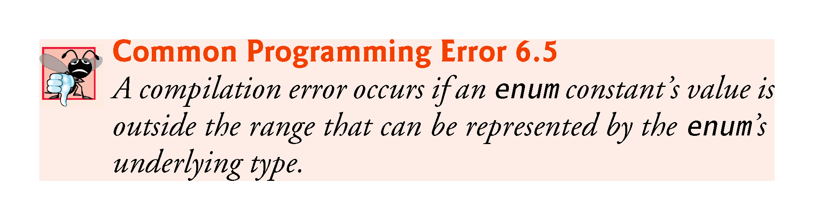

Slide 84
6.9 C++11 Random Numbers
According to CERT, function rand does not have “good statistical properties” and can be predictable, which makes programs that use rand less secure (CERT guideline MSC30-CPP).
C++11 provides a new, more secure library of random-number capabilities that can produce nondeterministic random numbers that can’t be predicted.
Such random-number generators are used in simulations and security scenarios where predictability is undesirable.
New capabilities are located in the C++ Standard Library’s <random> header.

Slide 85
6.9 C++11 Random Numbers (cont.)
For flexibility based on how random numbers are used in programs, C++11 provides many classes that represent various random-number generation engines and distributions.
An engine implements a random-number generation algorithm that produce pseudorandom numbers.
A distribution controls the range of values produced by an engine, the types of those values (e.g., int, double, etc.) and the statistical properties of the values.
uniform_int_distribution evenly distributes pseudorandom integers over a specified range of values.

Slide 86
6.9 C++11 Random Numbers (cont.)
Rolling a Six-Sided Die
Figure 6.10 uses the default_random_engine and the uniform_int_distribution to roll a six-sided die.
default_random_engine object named engine.
Its constructor argument seeds the random-number generation engine with the current time.
If you don’t pass a value to the constructor, the default seed will be used and the program will produce the same sequence of numbers each time it executes.
randomInt—a uniform_int_distribution object that produces unsigned int values (as specified by <unsigned int>) in the range 1 to 6 (as specified by the constructor arguments).
The expression randomInt(engine) returns one unsigned int value in the range 1 to 6.

Slide 87
6.9 C++11 Random Numbers (cont.)
The notation <unsigned int> indicates that uniform_int_distribution is a class template.
In this case, any integer type can be specified in the angle brackets (< and >).
In Chapter 18, we discuss how to create class templates and various other chapters show how to use existing class templates from the C++ Standard Library.
For now, you should feel comfortable using class template uniform_int_distribution by mimicking the syntax shown in the example.

Slide 88
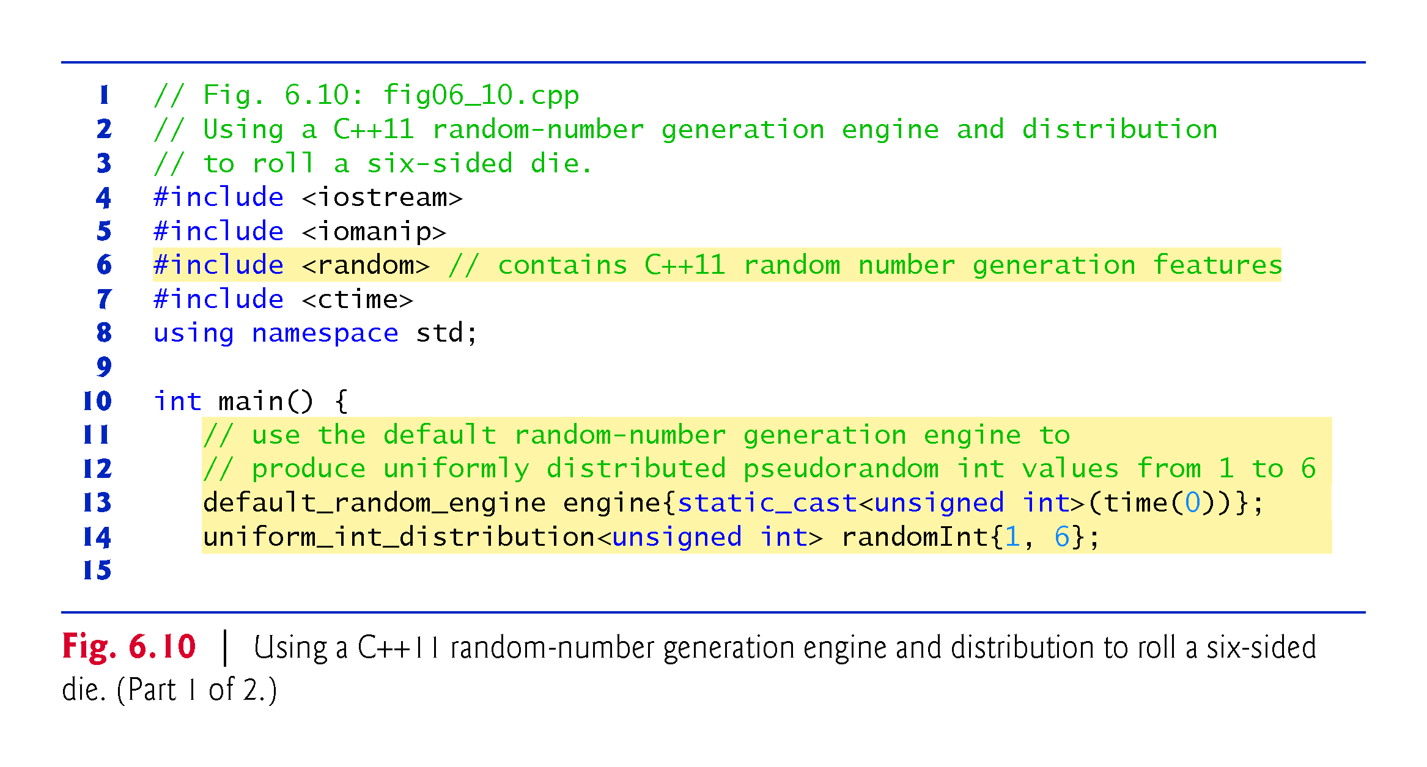

Slide 89
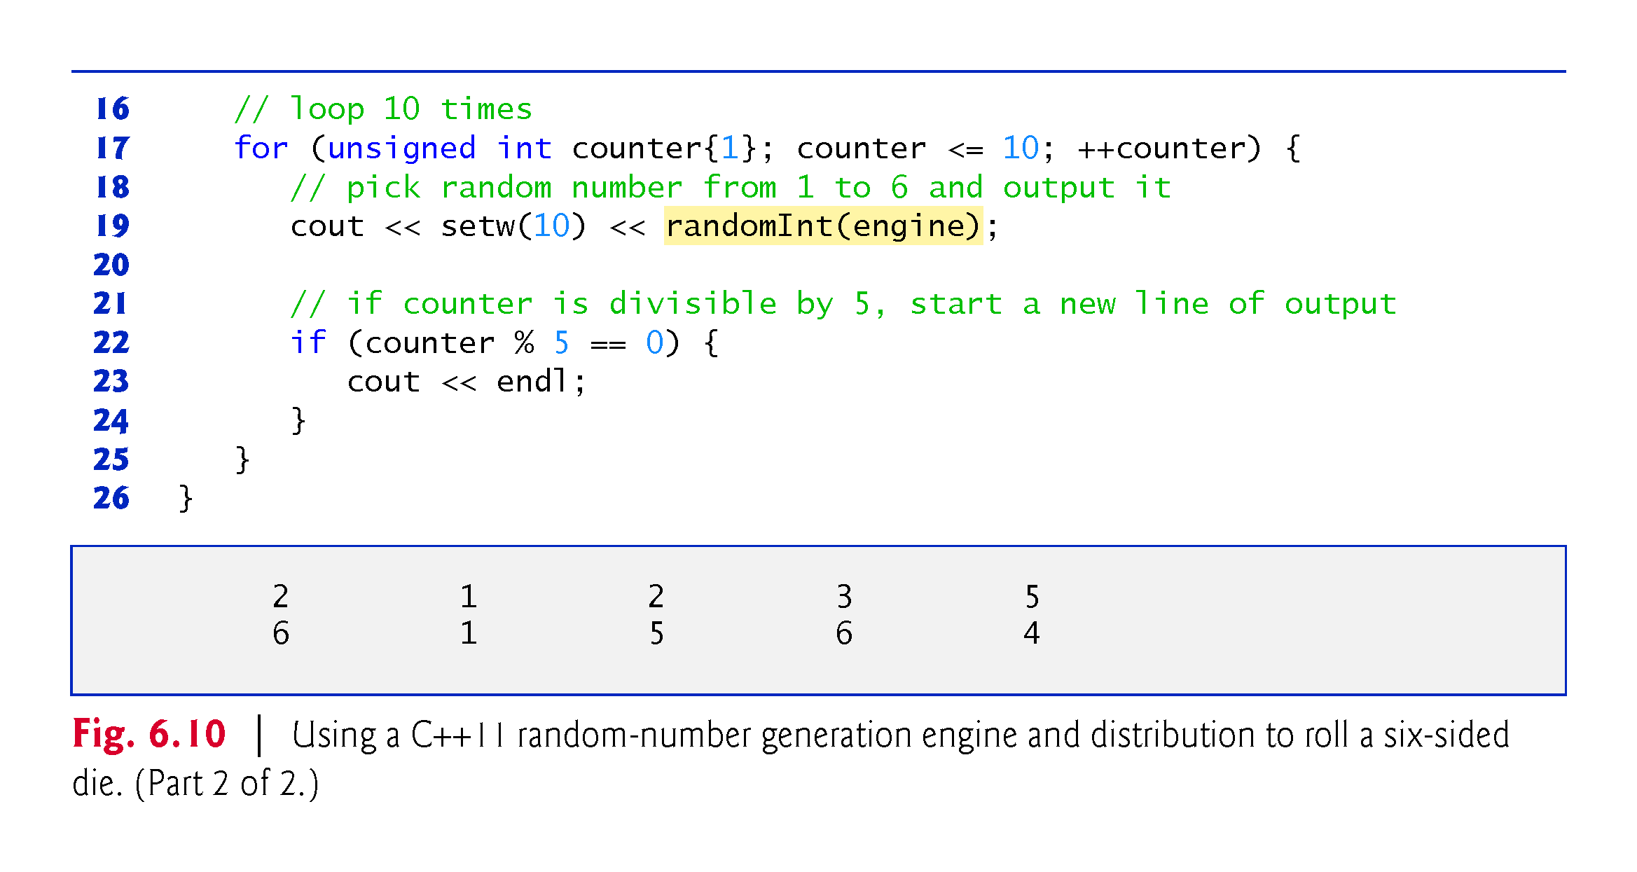

Slide 90
6.10 Scope Rules
The portion of the program where an identifier can be used is known as its scope.
This section discusses
block scope
global namespace scope

Slide 91
6.10 Scope Rules (cont.)
Identifiers declared inside a block have block scope, which begins at the identifier’s declaration and ends at the terminating right brace (}) of the enclosing block.
Local variables have block scope, as do function parameters.
Any block can contain variable declarations.
In nested blocks, if an identifier in an outer block has the same name as an identifier in an inner block, the one in the outer block is “hidden” until the inner block terminates.
The inner block “sees” its own local variable’s value and not that of the enclosing block’s identically named variable.

Slide 92


Slide 93


Slide 94
6.10 Scope Rules (cont.)
An identifier declared outside any function or class has global namespace scope.
“known” in all functions from the point at which it’s declared until the end of the file.
Function definitions, function prototypes placed outside a function, class definitions and global variables all have global namespace scope.
Global variables are created by placing variable declarations outside any class or function definition. Such variables retain their values throughout a program’s execution.

Slide 95


Slide 96


Slide 97
6.10 Scope Rules (cont.)
Scope Demonstration
The program of Fig. 6.11 demonstrates scoping issues with global variables, automatic local variables and static local variables.

Slide 98


Slide 99


Slide 100


Slide 101


Slide 102
6.11 Function Call Stack and Activation Records
To understand how C++ performs function calls, we first need to consider a data structure (i.e., collection of related data items) known as a stack.
Analogous to a pile of dishes.
When a dish is placed on the pile, it’s normally placed at the top—referred to as pushing.
Similarly, when a dish is removed from the pile, it’s normally removed from the top—referred to as popping.
Last-in, first-out (LIFO) data structures—the last item pushed (inserted) is the first item popped (removed).

Slide 103
6.11 Function Call Stack and Activation Records (cont.)
Function-Call Stack
One of the most important mechanisms for computer science students to understand is the function call stack (or program execution stack).
supports the function call/return mechanism.
Also supports the creation, maintenance and destruction of each called function’s automatic variables.

Slide 104
6.11 Function Call Stack and Activation Records (cont.)
Stack Frames
Each function eventually must return control to the function that called it.
Each time a function calls another function, an entry is pushed onto the function call stack.
This entry, called a stack frame or an activation record, contains the return address that the called function needs in order to return to the calling function.

Slide 105
6.11 Function Call Stack and Activation Records (cont.)
Automatic Local Variables and Stack Frames
When a function call returns, the stack frame for the function call is popped, and control transfers to the return address in the popped stack frame.
Stack Overflow
The amount of memory in a computer is finite, so only a certain amount of memory can be used to store activation records on the function call stack.
If more function calls occur than can have their activation records stored on the function call stack, an a fatal error known as stack overflow occurs.

Slide 106
6.11 Function Call Stack and Activation Records (cont.)
Function Call Stack in Action
Now let’s consider how the call stack supports the operation of a square function called by main (Fig. 6.12).
First the operating system calls main—this pushes an activation record onto the stack (shown in Fig. 6.13).
The activation record tells main how to return to the operating system (i.e., transfer to return address R1) and contains the space for main’s automatic variable (i.e., a, which is initialized to 10).

Slide 107


Slide 108


Slide 109
6.12 Function Call Stack and Activation Records (cont.)
Function main—before returning to the operating system—now calls function square in line 12 of Fig. 6.12.
This causes a stack frame for square (lines 16–18) to be pushed onto the function call stack (Fig. 6.14).
This stack frame contains the return address that square needs to return to main (i.e., R2) and the memory for square’s automatic variable (i.e., x).

Slide 110


Slide 111
6.12 Function Call Stack and Activation Records (cont.)
After square calculates the square of its argument, it needs to return to main—and no longer needs the memory for its automatic variable x. So square’s stack frame is popped from the stack—giving square the return location in main (i.e., R2) and losing square’s automatic variable.
Figure 6.15 shows the function call stack after square’s activation record has been popped.

Slide 112


Slide 113
6.12 Inline Functions
C++ provides inline functions to help reduce function call overhead.
Placing the qualifier inline before a function’s return type in the function definition advises the compiler to generate a copy of the function’s code in every place where the function is called (when appropriate) to avoid a function call.
This often makes the program larger.
Reusable inline functions are typically placed in headers, so that their definitions can be included in each source file that uses them.

Slide 114


Slide 115


Slide 116
6.14 Inline Functions
Figure 6.16 uses inline function cube (lines 9–11) to calculate the volume of a cube.
Keyword const in function cube’s parameter list (line 9) tells the compiler that the function does not modify variable side.
This ensures that side’s value is not changed by the function during the calculation.

Slide 117


Slide 118


Slide 119
6.13 References and Reference Parameters
Two ways to pass arguments to functions in many programming languages are pass-by-value and pass-by-reference.
When an argument is passed by value, a copy of the argument’s value is made and passed (on the function call stack) to the called function.
Changes to the copy do not affect the original variable’s value in the caller.
To specify a reference to a constant, place the const qualifier before the type specifier in the parameter declaration.

Slide 120


Slide 121
6.15 References and Reference Parameters (cont.)
With pass-by-reference, the caller gives the called function the ability to access the caller’s data directly, and to modify that data.
A reference parameter is an alias for its corresponding argument in a function call.
To indicate that a function parameter is passed by reference, simply follow the parameter’s type in the function prototype by an ampersand (&); use the same convention when listing the parameter’s type in the function header.
Figure 6.17 compares pass-by-value and pass-by-reference with reference parameters.

Slide 122


Slide 123


Slide 124


Slide 125


Slide 126


Slide 127
6.15 References and Reference Parameters (cont.)
References can also be used as aliases for other variables within a function.
Reference variables must be initialized in their declarations and cannot be reassigned as aliases to other variables.
Once a reference is declared as an alias for another variable, all operations supposedly performed on the alias are actually performed on the original variable.

Slide 128
6.15 References and Reference Parameters (cont.)
To specify that a reference parameter should not be allowed to modify the corresponding argument, place the const qualifier before the type name in the parameter’s declaration.
string objects can be large, so they (and objects in general) should be passed to functions by reference.

Slide 129


Slide 130
6.15 References and Reference Parameters (cont.)
Functions can return references, but this can be dangerous.
When returning a reference to a variable declared in the called function, the variable should be declared static in that function.

Slide 131


Slide 132
6.14 Default Arguments
It common for a program to invoke a function repeatedly with the same argument value for a particular parameter.
Can specify that such a parameter has a default argument, i.e., a default value to be passed to that parameter.
When a program omits an argument for a parameter with a default argument in a function call, the compiler rewrites the function call and inserts the default value of that argument.
Figure 6.18 demonstrates using default arguments to calculate a box’s volume.

Slide 133


Slide 134


Slide 135
6.14 Default Arguments
Default arguments must be the rightmost (trailing) arguments in a function’s parameter list.
When calling a function with two or more default arguments, if an omitted argument is not the rightmost argument, then all arguments to the right of that argument also must be omitted.
Default arguments must be specified with the first occurrence of the function name—typically, in the function prototype.
Default values can be any expression, including constants, global variables or function calls. Default arguments also can be used with inline functions.

Slide 136


Slide 137
6.15 Unary Scope Resolution Operator
C++ provides the unary scope resolution operator (::) to access a global variable when a local variable of the same name is in scope.
Using the unary scope resolution operator (::) with a given variable name is optional when the only variable with that name is a global variable.
Figure 6.19 shows the unary scope resolution operator with local and global variables of the same name.

Slide 138


Slide 139


Slide 140


Slide 141


Slide 142


Slide 143
6.16 Function Overloading
C++ enables several functions of the same name to be defined, as long as they have different signatures.
This is called function overloading.
The C++ compiler selects the proper function to call by examining the number, types and order of the arguments in the call.
Function overloading is used to create several functions of the same name that perform similar tasks, but on different data types.

Slide 144


Slide 145
6.16 Function Overloading (cont.)
Figure 6.20 uses overloaded square functions to calculate the square of an int and the square of a double.

Slide 146


Slide 147


Slide 148
6.16 Function Overloading (cont.)
How the Compiler Differentiates Among Overloaded Functions
Overloaded functions are distinguished by their signatures.
A signature is a combination of a function’s name and its parameter types (in order).
The compiler encodes each function identifier with the types of its parameters (sometimes referred to as name mangling or name decoration) to enable type-safe linkage.
Ensures that the proper overloaded function is called and that the types of the arguments conform to the types of the parameters.
Figure 6.21 was compiled with GNU C++.
Rather than showing the execution output of the program, we show the mangled function names produced in assembly language by GNU C++.

Slide 149


Slide 150


Slide 151
6.16 Function Overloading (cont.)
For GNU C++, each mangled name (other than main) begins with two underscores (__) followed by the letter Z, a number and the function name.
The number specifies how many characters are in the function’s name.
The compiler distinguishes the two square functions by their parameter lists—one specifies i for int and the other d for double.
The return types of the functions are not specified in the mangled names.
Overloaded functions can have different return types, but if they do, they must also have different parameter lists.
Function-name mangling is compiler specific.

Slide 152


Slide 153


Slide 154
6.17 Function Templates
If the program logic and operations are identical for each data type, overloading may be performed more compactly and conveniently by using function templates.
You write a single function template definition.
Given the argument types provided in calls to this function, C++ automatically generates separate function template specializations to handle each type of call appropriately.

Slide 155
6.17 Function Templates (cont.)
Figure 6.22 defines a maximum function that determines the largest of three values.
All function template definitions begin with the template keyword followed by a template parameter list enclosed in angle brackets (< and >).
Every parameter in the template parameter list is preceded by keyword typename or keyword class.
The type parameters are placeholders for fundamental types or user-defined types.
Used to specify the types of the function’s parameters, to specify the function’s return type and to declare variables within the body of the function definition.

Slide 156


Slide 157
6.19 Function Templates (cont.)
Figure 6.23 uses the maximum function template to determine the largest of three int values, three double values and three char values, respectively.
Separate functions are created as a result of the calls—expecting three int values, three double values and three char values, respectively.

Slide 158


Slide 159


Slide 160
6.18 Recursion
A recursive function is a function that calls itself, either directly, or indirectly (through another function).
Recursive problem-solving approaches have a number of elements in common.
A recursive function is called to solve a problem.
The function actually knows how to solve only the simplest case(s), or so-called base case(s).
If the function is called with a base case, the function simply returns a result.
If the function is called with a more complex problem, it typically divides the problem into two conceptual pieces—a piece that the function knows how to do and a piece that it does not know how to do.
This new problem looks like the original, so the function calls a copy of itself to work on the smaller problem—this is referred to as a recursive call and is also called the recursion step.

Slide 161


Slide 162
6.18 Recursion (cont.)
The recursion step often includes the key-word return, because its result will be combined with the portion of the problem the function knew how to solve to form the result passed back to the original caller, possibly main.
The recursion step executes while the original call to the function is still “open,” i.e., it has not yet finished executing.
The recursion step can result in many more such recursive calls.

Slide 163
6.18 Recursion (cont.)
Factorial
The factorial of a nonnegative integer n, written n! (and pronounced “n factorial”), is the product
n · (n – 1) · (n – 2) · … · 1
with 1! equal to 1, and 0! defined to be 1.

Slide 164
6.18 Recursion (cont.)
Iterative Factorial
The factorial of an integer, number, greater than or equal to 0, can be calculated iteratively (nonrecursively) by using a loop.
Recursive Factorial
A recursive definition of the factorial function is arrived at by observing the following algebraic relationship:
n! = n · (n – 1)!

Slide 165
6.18 Recursion (cont.)
Evaluating 5!
The evaluation of 5! would proceed as shown in Fig. 6.24, which illustrates how the succession of recursive calls proceeds until 1! is evaluated to be 1, terminating the recursion.
Figure 6.24(b) shows the values returned from each recursive call to its caller until the final value is calculated and returned.

Slide 166


Slide 167
6.18 Recursion (cont.)
Using a Recursive factorial Function to Calculate Factorials
Figure 6.25 uses recursion to calculate and print the factorials of the integers 0–10.

Slide 168


Slide 169


Slide 170
6.18 Recursion (cont.)
C++11 Type unsigned long long int
C++11’s unsigned long long int type (which can be abbreviated as unsigned long long ) on some systems enables you to store values in at least 8 bytes (64 bits) which can hold numbers as large as 18,446,744,073,709,551,615.

Slide 171
6.19 Example Using Recursion: Fibonacci Series
The Fibonacci series
0, 1, 1, 2, 3, 5, 8, 13, 21, …
begins with 0 and 1 and has the property that each subsequent Fibonacci number is the sum of the previous two Fibonacci numbers.
The series occurs in nature and, in particular, describes a form of spiral.
The ratio of successive Fibonacci numbers converges on a constant value of 1.618….
This frequently occurs in nature and has been called the golden ratio or the golden mean.
Humans tend to find the golden mean aesthetically pleasing.

Slide 172
6.19 Example Using Recursion: Fibonacci Series (cont.)
Recursive Fibonacci Definition
The Fibonacci series can be defined recursively as follows:
fibonacci(0) = 0 fibonacci(1) = 1 fibonacci(n) = fibonacci(n – 1) + fibonacci(n – 2)
The program of Fig. 6.26 calculates the nth Fibonacci number recursively by using function fibonacci.

Slide 173


Slide 174


Slide 175


Slide 176
6.19 Example Using Recursion: Fibonacci Series (cont.)
Figure 6.27 shows how function fibonacci would evaluate fibonacci(3).
Figure raises interesting issues about the order in which C++ compilers evaluate the operands of operators.
Separate issue from the order in which operators are applied to their operands, namely, the order dictated by the rules of operator precedence and associativity.
Most programmers assume that operands are evaluated left to right.
C++ does not specify the order in which the operands of most operators (including +) are to be evaluated.
Therefore, you must make no assumption about the order in which these calls execute.

Slide 177


Slide 178


Slide 179


Slide 180


Slide 181


Slide 182


Slide 183
6.20 Recursion vs. Iteration
Both iteration and recursion are based on a control statement:
Iteration uses an iteration statement
Recursion uses a selection statement.
Both iteration and recursion involve iteration:
Iteration explicitly uses an iteration statement
Recursion achieves repetition through repeated function calls.
Iteration and recursion each involve a termination test:
Iteration terminates when the loop-continuation condition fails
Recursion terminates when a base case is recognized.

Slide 184
6.22 Recursion vs. Iteration (cont.)
Counter-controlled iteration and recursion both gradually approach termination:
Iteration modifies a counter until the counter assumes a value that makes the loop-continuation condition fail
Recursion produces simpler versions of the original problem until the base case is reached.
Both iteration and recursion can occur infinitely:
An infinite loop occurs with iteration if the loop-continuation test never becomes false
Infinite recursion occurs if the recursion step does not reduce the problem during each recursive call in a manner that converges on the base case.
To illustrate the differences between iteration and recursion, Fig. 6.28 presents an iterative solution to the factorial problem.

Slide 185


Slide 186


Slide 187


Slide 188


Slide 189


Slide 190


Slide 191


Slide 192


